Slide 1

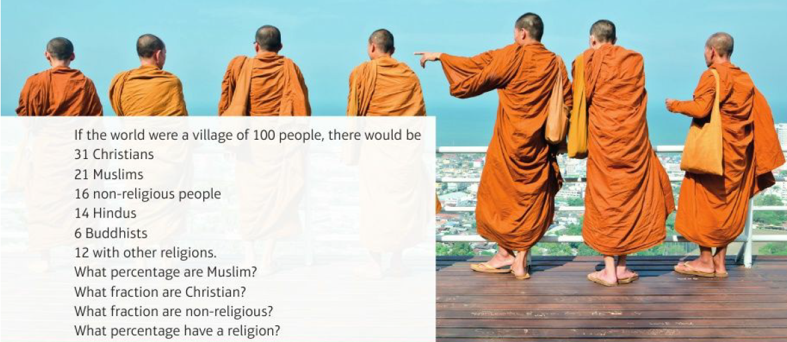
Mathematics (9-1) - iGCSE
2018-20
Year 09
Unit 4 – Fractions, Ratios & Percentages

Slide 2
Contents
Page iv
4 Fractions, ratio and percentages 97
Prior knowledge check 97
4.1 Fractions 98
4.2 Ratios 101
4.3 Ratio and proportion 103
4.4 Percentages 105
4.5 Fractions, decimals and percentages 108
Problem-solving
Check up
Strengthen
Extend
Knowledge check
Unit test

Slide 3
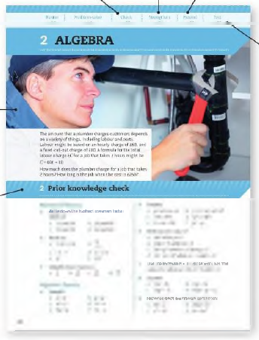
Contents
Page v
At the end of the Master lessons, take a check-up test to help you to decide whether to strengthen or Extend our learning
Extend helps you to apply the maths you know to some different situations
Unit Openers put the maths you are about to learn into a real-life context. Have a go at the question - it uses maths you have already learnt so you should be able to answer it at the start of the unit.
When you have finished the whole unit, a Unit test helps you see how much progress you are making.
Choose only the topics in strengthen thay you need a bit more practice with. You’ll find more hints here to lead you through specific questions. Then move on to Extend
Use the Prior knowledge check to make sure you are ready to start the main lessons in the unit. It checks your knowledge from Key Stage 3 and from earlier in the GCSE course. Your teacher has access to worksheets if you need to recap anything.

Slide 4
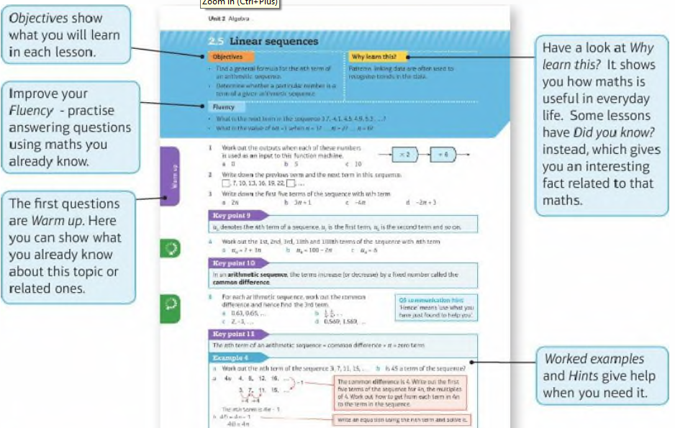
Contents
Page vi

Slide 5
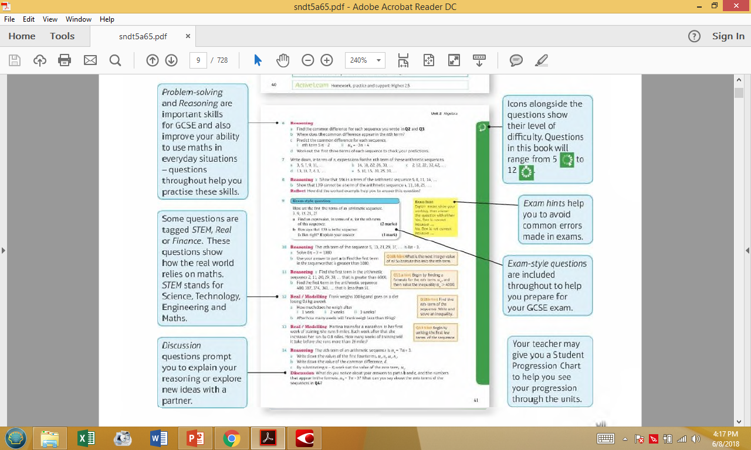
Contents
Page vi

Slide 6
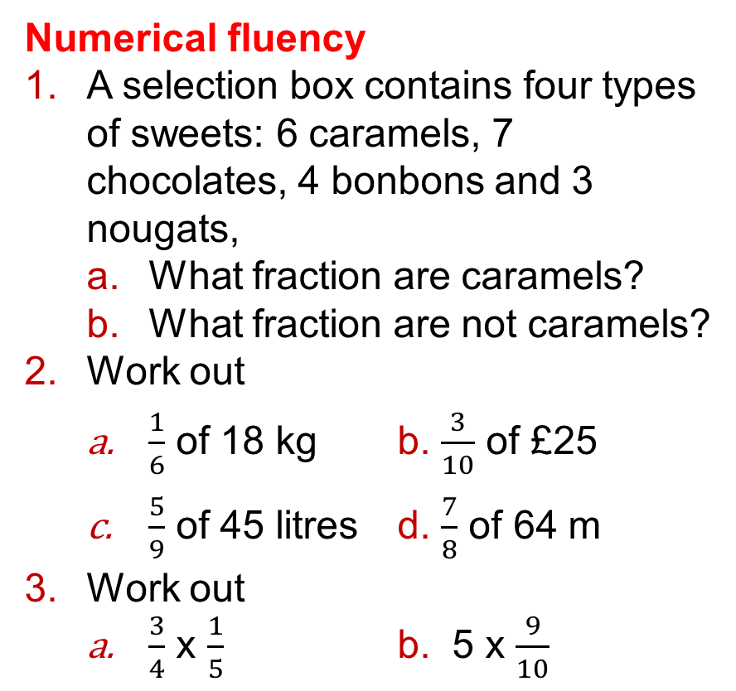
4 – Prior Knowledge Check
Page 97
Numerical fluency
A selection box contains four types of sweets: 6 caramels, 7 chocolates, 4 bonbons and 3 nougats,
  What fraction are caramels?
  What fraction are not caramels?
Work out
  $\frac{1}{6}$ of 18 kg b. $\frac{3}{10}$ of £25
  $\frac{5}{9}$ of 45 litres d. $\frac{7}{8}$ of 64 m
Work out
  $\frac{3}{4}$ x $\frac{1}{5}$ b. 5 x $\frac{9}{10}$

Slide 7
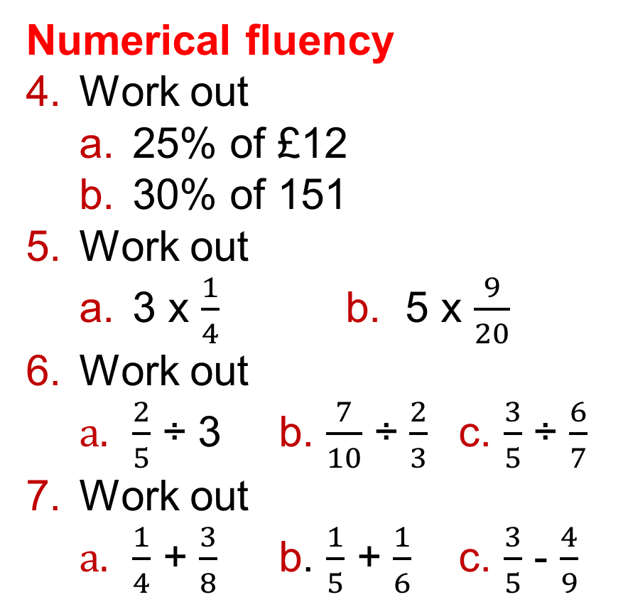
4 – Prior Knowledge Check
Page 97
Numerical fluency
Work out
  25% of £12
  30% of 151
Work out
  3 x $\frac{1}{4}$ b. 5 x $\frac{9}{20}$
Work out
  $\frac{2}{5}$ ÷ 3 b. $\frac{7}{10}$ ÷ $\frac{2}{3}$ c. $\frac{3}{5}$ ÷ $\frac{6}{7}$
Work out
  $\frac{1}{4}$ + $\frac{3}{8}$ b. $\frac{1}{5}$ + $\frac{1}{6}$ c. $\frac{3}{5}$ - $\frac{4}{9}$

Slide 8
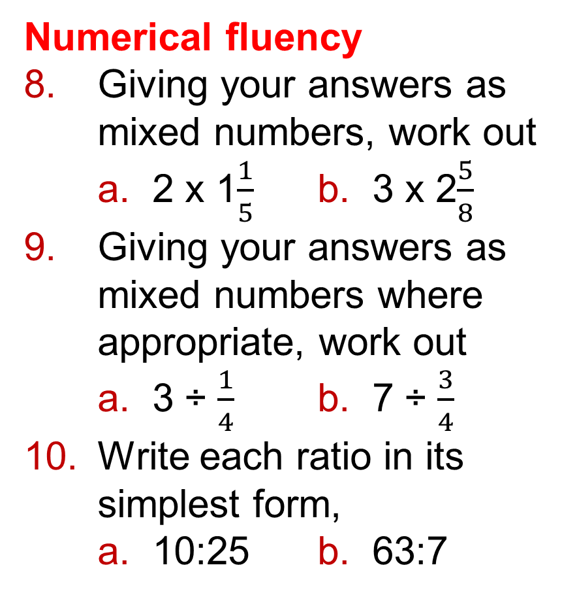
4 – Prior Knowledge Check
Page 97
Numerical fluency
Giving your answers as mixed numbers, work out
  2 x 1$\frac{1}{5}$ b. 3 x 2$\frac{5}{8}$
Giving your answers as mixed numbers where appropriate, work out
  3 ÷ $\frac{1}{4}$ b. 7 ÷ $\frac{3}{4}$
Write each ratio in its simplest form,
  10:25 b. 63:7

Slide 9
4 – Prior Knowledge Check
Page 97
Numerical fluency
There are 40 girls and 25 boys at a holiday camp.
What is the ratio of girls to boys?
Give your answer in its simplest form.
A loom band bracelet uses green and blue rubber bands in the ratio 3:1.
What fraction of the rubber bands are blue?

Slide 10
4 – Prior Knowledge Check
Page 98
Numerical fluency
Here are the ingredients needed to make 8 scones
  How many eggs would you need to make 24 scones?
  How much butter would you need to make 12 scones?
Use a multiplier to calculate these percentages.
  20% of £78 b. 70% of 52 kg
  45% of 340 ml
  8% of 510 m
275g self-raising flour
25 g sugar 50 g butter 1 egg

Slide 11
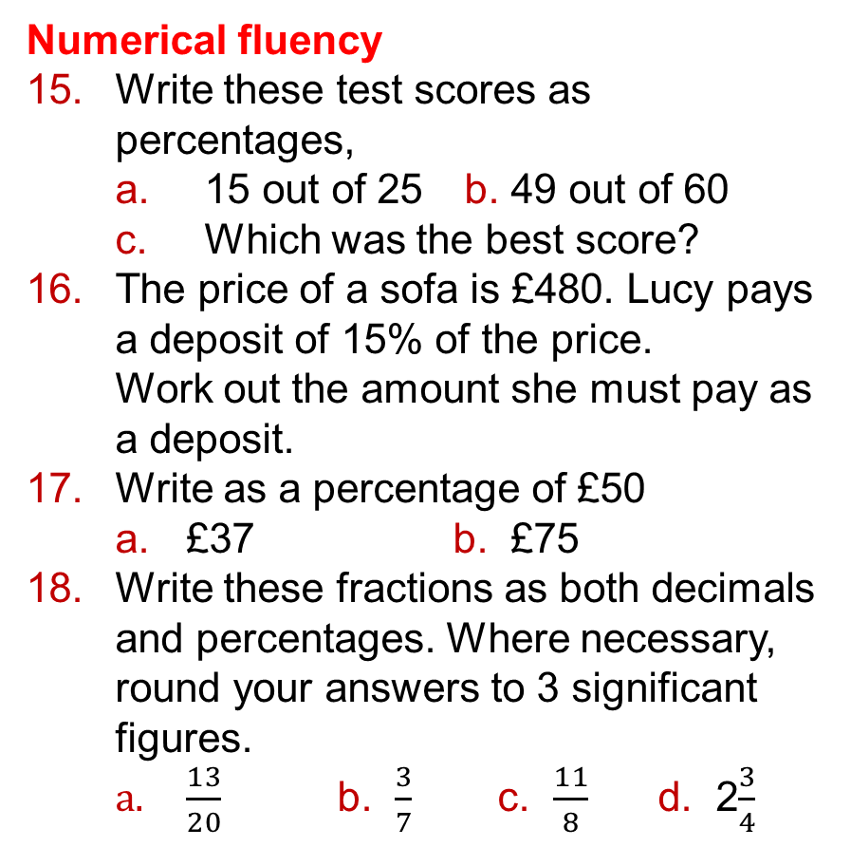
4 – Prior Knowledge Check
Page 98
Numerical fluency
Write these test scores as percentages,
  15 out of 25 b. 49 out of 60
  Which was the best score?
The price of a sofa is £480. Lucy pays a deposit of 15% of the price.
Work out the amount she must pay as a deposit.
Write as a percentage of £50
  £37 b. £75
Write these fractions as both decimals and percentages. Where necessary, round your answers to 3 significant figures.
  $\frac{13}{20}$ b. $\frac{3}{7}$ c. $\frac{11}{8}$ d. 2$\frac{3}{4}$

Slide 12

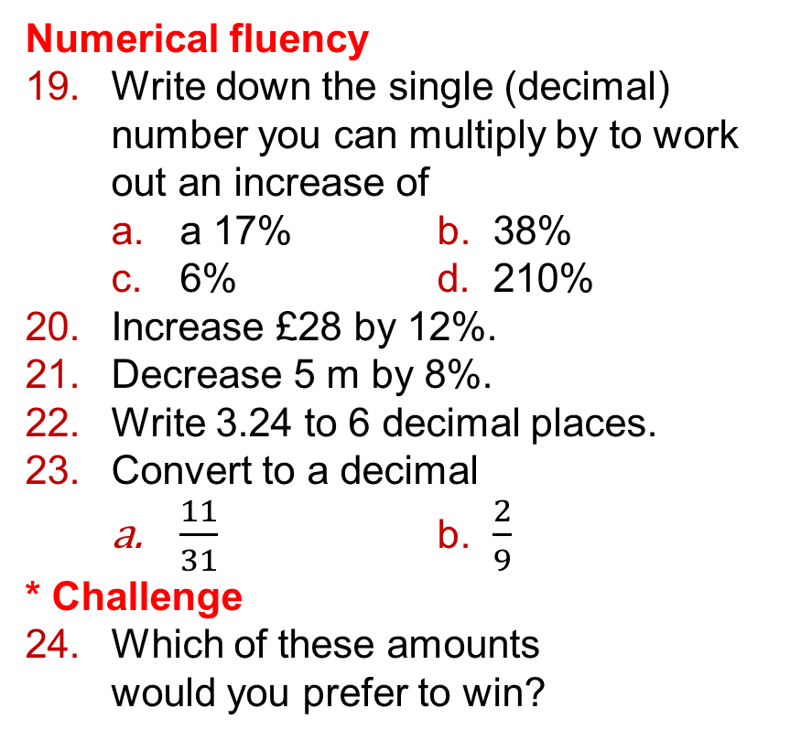
4 – Prior Knowledge Check
Page 98
Numerical fluency
Write down the single (decimal) number you can multiply by to work out an increase of
  a 17% b. 38%
  6% d. 210%
Increase £28 by 12%.
Decrease 5 m by 8%.
Write 3.24 to 6 decimal places.
Convert to a decimal
  $\frac{11}{31}$ b. $\frac{2}{9}$
* Challenge
Which of these amounts
would you prefer to win?
0.8 of £90
55% of £150
$\frac{3}{4}$ of £120
300% of £28

Slide 13
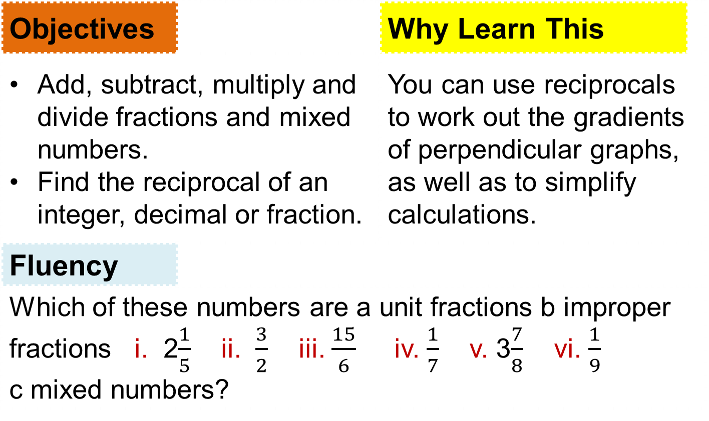
4.1 - Fractions
Page 37
Objectives |  | Why Learn This
Add, subtract, multiply and divide fractions and mixed numbers. Find the reciprocal of an integer, decimal or fraction. |  | You can use reciprocals to work out the gradients of perpendicular graphs, as well as to simplify calculations.
Fluency
Which of these numbers are a unit fractions b improper fractions i. 2$\frac{1}{5}$ ii. $\frac{3}{2}$ iii. $\frac{15}{6}$ iv. $\frac{1}{7}$ v. 3$\frac{7}{8}$ vi. $\frac{1}{9}$ c mixed numbers?
ActiveLearn - Homework, practice and support: Higher 4.1

Slide 14
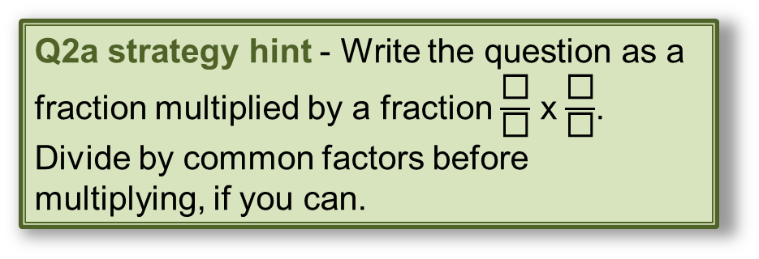
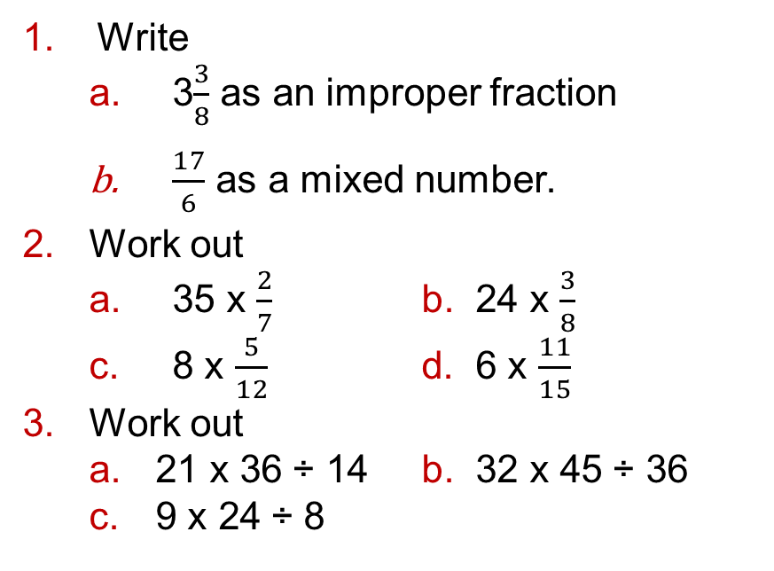
4.1 - Fractions
Page 98
Write
  3$\frac{3}{8}$ as an improper fraction
  $\frac{17}{6}$ as a mixed number.
Work out
  35 x $\frac{2}{7}$ b. 24 x $\frac{3}{8}$
  8 x $\frac{5}{12}$ d. 6 x $\frac{11}{15}$
Work out
  21 x 36 ÷ 14 b. 32 x 45 ÷ 36
  9 x 24 ÷ 8
Warm Up
Q2a strategy hint - Write the question as a fraction multiplied by a fraction $\frac{\text{◻}}{\text{◻}}$ x $\frac{\text{◻}}{\text{◻}}$.
Divide by common factors before multiplying, if you can.

Slide 15

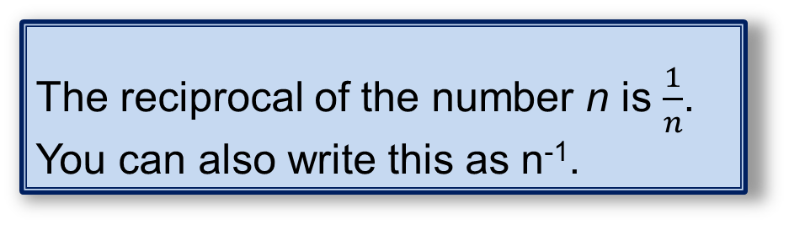
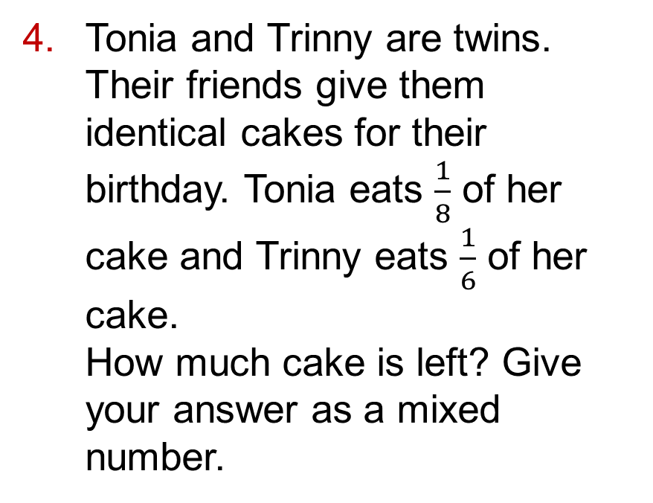
4.1 - Fractions
Page 99
Tonia and Trinny are twins. Their friends give them identical cakes for their birthday. Tonia eats $\frac{1}{8}$ of her cake and Trinny eats $\frac{1}{6}$ of her cake.
How much cake is left? Give your answer as a mixed number.
Key Point 1
The reciprocal of the number n is $\frac{1}{n}$. You can also write this as n⁻¹.

Slide 16

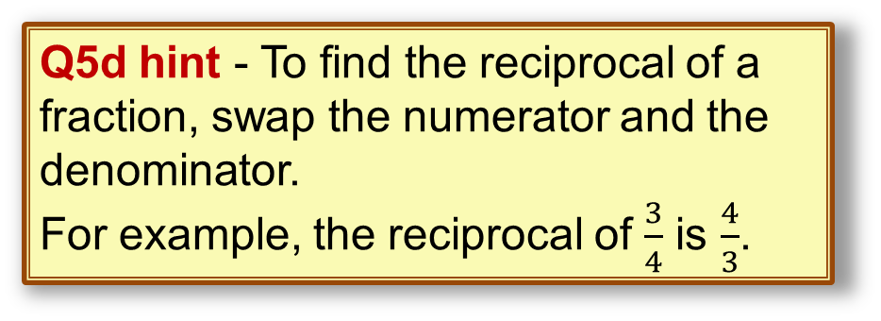
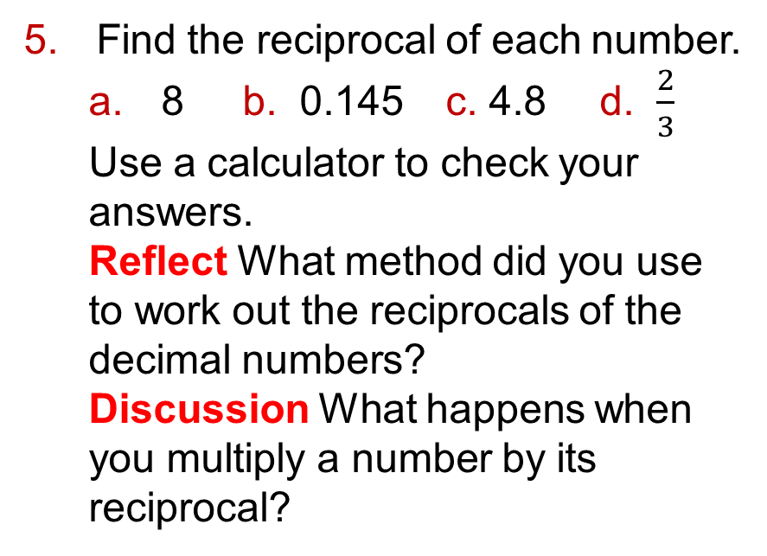
4.1 - Fractions
Page 99
Find the reciprocal of each number.
  8 b. 0.145 c. 4.8 d. $\frac{2}{3}$
  Use a calculator to check your answers.
  Reflect What method did you use to work out the reciprocals of the decimal numbers?
  Discussion What happens when you multiply a number by its reciprocal?
Q5d hint - To find the reciprocal of a fraction, swap the numerator and the denominator.
For example, the reciprocal of $\frac{3}{4}$ is $\frac{4}{3}$.

Slide 17
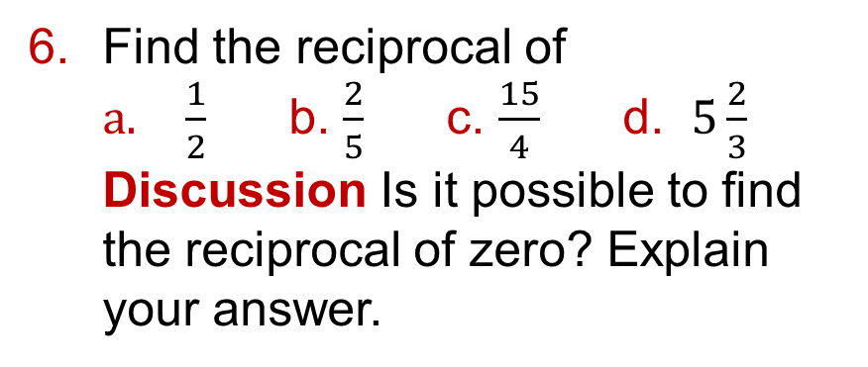
4.1 - Fractions
Page 99
Find the reciprocal of
  $\frac{1}{2}$ b. $\frac{2}{5}$ c. $\frac{15}{4}$ d. $5\frac{2}{3}$
  Discussion Is it possible to find the reciprocal of zero? Explain your answer.
Q6d hint - To find the reciprocal of a mixed number, first convert it into an improper fraction.
Key Point 2
It is often easier to write mixed numbers as improper fractions before doing a calculation.

Slide 18

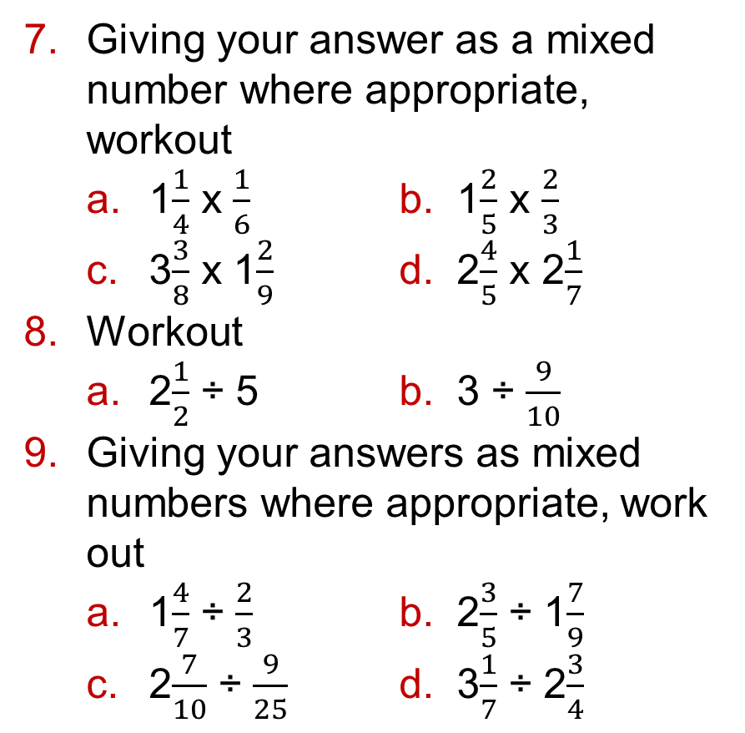
4.1 - Fractions
Page 99
Giving your answer as a mixed number where appropriate, workout
  1$\frac{1}{4}$ x $\frac{1}{6}$ b. 1$\frac{2}{5}$ x $\frac{2}{3}$
  3$\frac{3}{8}$ x 1$\frac{2}{9}$ d. 2$\frac{4}{5}$ x 2$\frac{1}{7}$
Workout
  2$\frac{1}{2}$ ÷ 5 b. 3 ÷ $\frac{9}{10}$
Giving your answers as mixed numbers where appropriate, work out
  1$\frac{4}{7}$ ÷ $\frac{2}{3}$ b. 2$\frac{3}{5}$ ÷ 1$\frac{7}{9}$
  2$\frac{7}{10}$ ÷ $\frac{9}{25}$ d. 3$\frac{1}{7}$ ÷ 2$\frac{3}{4}$

Slide 19
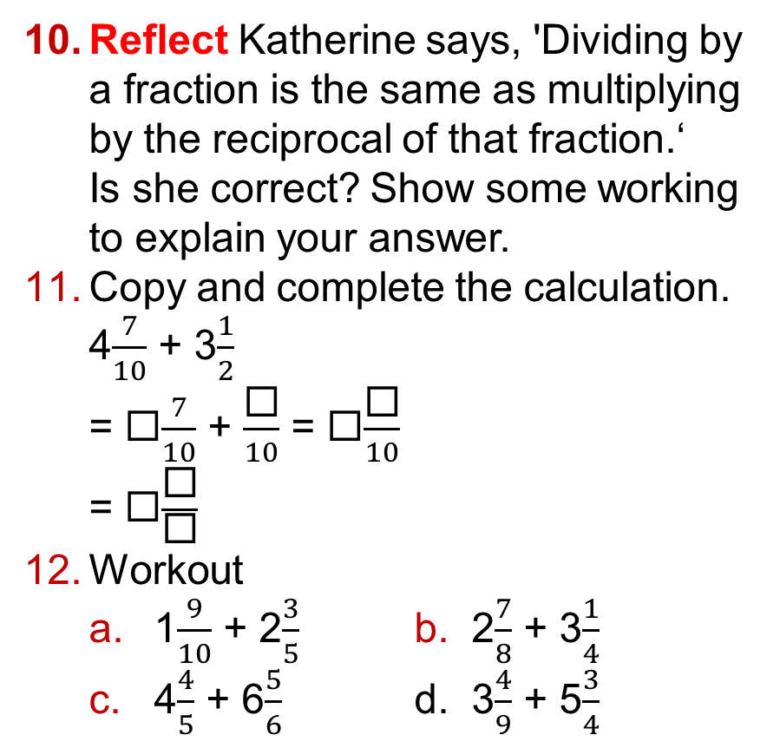
4.1 - Fractions
Page 99
Reflect Katherine says, 'Dividing by a fraction is the same as multiplying by the reciprocal of that fraction.‘
Is she correct? Show some working to explain your answer.
Copy and complete the calculation.
  4$\frac{7}{10}$ + 3$\frac{1}{2}$
  = ◻$\frac{7}{10}$ + $\frac{\text{◻}}{10}$ = ◻$\frac{\text{◻}}{10}$
  = ◻$\frac{\text{◻}}{\text{◻}}$
Workout
  1$\frac{9}{10}$ + 2$\frac{3}{5}$ b. 2$\frac{7}{8}$ + 3$\frac{1}{4}$
  4$\frac{4}{5}$ + 6$\frac{5}{6}$ d. 3$\frac{4}{9}$ + 5$\frac{3}{4}$
Q12c hint - Sometimes both denominators must be changed to add fractions.

Slide 20


4.1 - Fractions
Page 100
13 – Exam-Style Questions
A part has broken on a machine and needs to be replaced. The replacement must be between 7$\frac{1}{18}$ cm and 7$\frac{3}{18}$cm long in order to fit the machine.
The diagram shows the
replacement part.
Will this part fit the
machine?
You must explain your answer. (5 marks)
Exam hint
Explain your answer by showing your calculations. Write a sentence,
'The part will/will not fit the machine because ...’

Slide 21
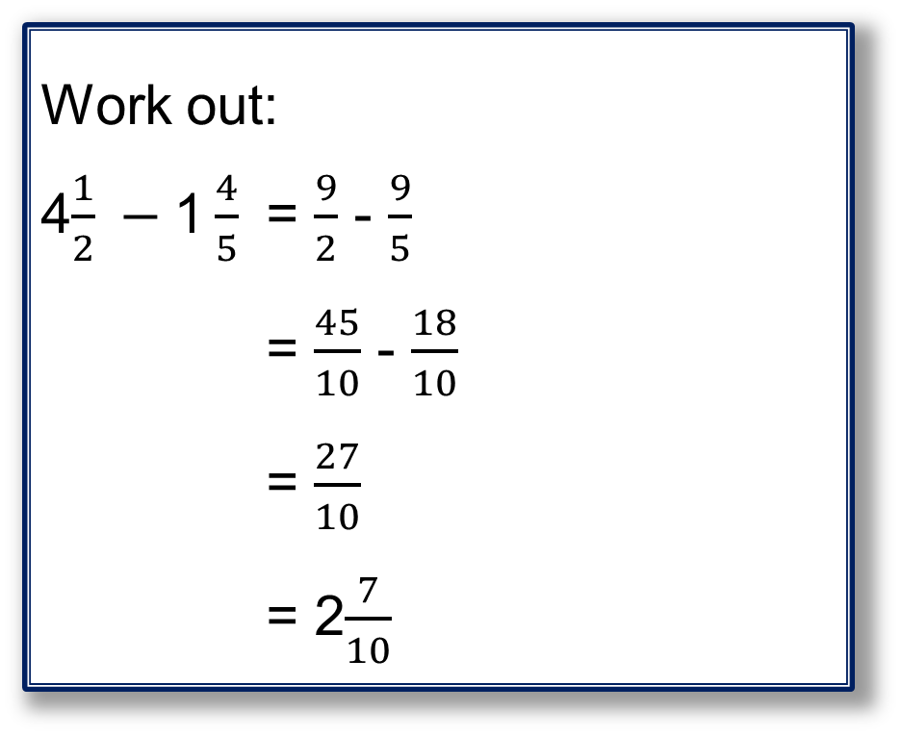
4.1 - Fractions
Page 100
Example 1
Work out:
4$\frac{1}{2} −\text{1}\frac{4}{5}$ = $\frac{9}{2}$ - $\frac{9}{5}$
= $\frac{45}{10}$ - $\frac{18}{10}$
= $\frac{27}{10}$
= 2$\frac{7}{10}$
Write both numbers as improper fractions
Write both fractions with a common denominator
Write the answer as a mixed number

Slide 22
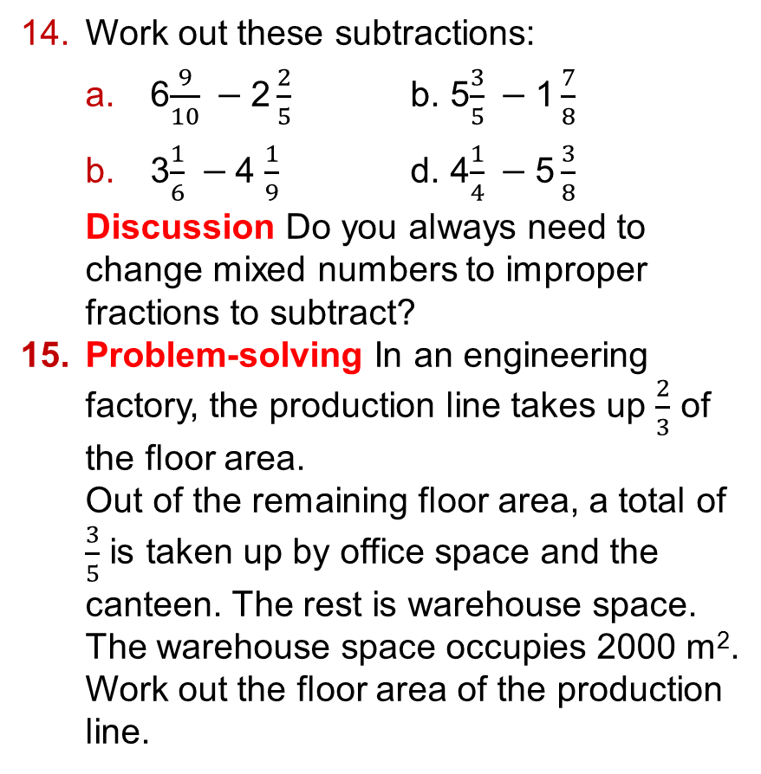
4.1 - Fractions
Page 100
Work out these subtractions:
  6$\frac{9}{10} −\text{2}\frac{2}{5}$ b. 5$\frac{3}{5} −\text{1}\frac{7}{8}$
  3$\frac{1}{6} −\text{4}$ $\frac{1}{9}$ d. 4$\frac{1}{4} −\text{5}\frac{3}{8}$
  Discussion Do you always need to change mixed numbers to improper fractions to subtract?
  Problem-solving In an engineering factory, the production line takes up $\frac{2}{3}$ of the floor area.
  Out of the remaining floor area, a total of $\frac{3}{5}$ is taken up by office space and the canteen. The rest is warehouse space.
  The warehouse space occupies 2000 m².
  Work out the floor area of the production line.

Slide 23
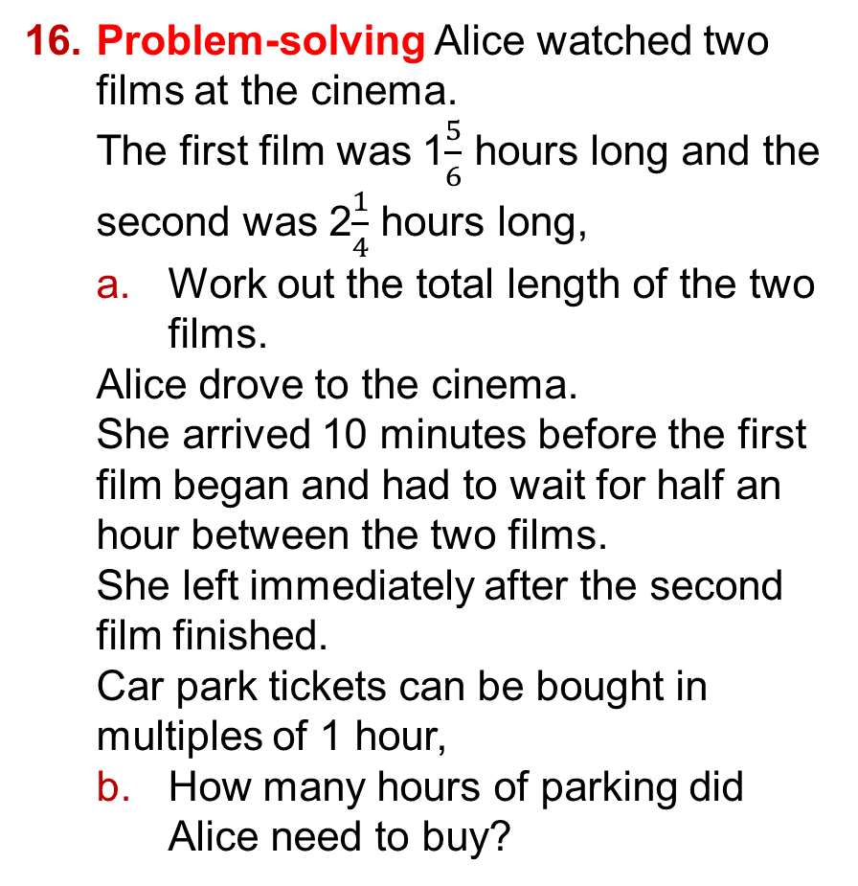
4.1 - Fractions
Page 100
Problem-solving Alice watched two films at the cinema.
The first film was 1$\frac{5}{6}$ hours long and the second was 2$\frac{1}{4}$ hours long,
  Work out the total length of the two films.
  Alice drove to the cinema.
  She arrived 10 minutes before the first film began and had to wait for half an hour between the two films.
  She left immediately after the second film finished.
  Car park tickets can be bought in multiples of 1 hour,
  How many hours of parking did Alice need to buy?

Slide 24
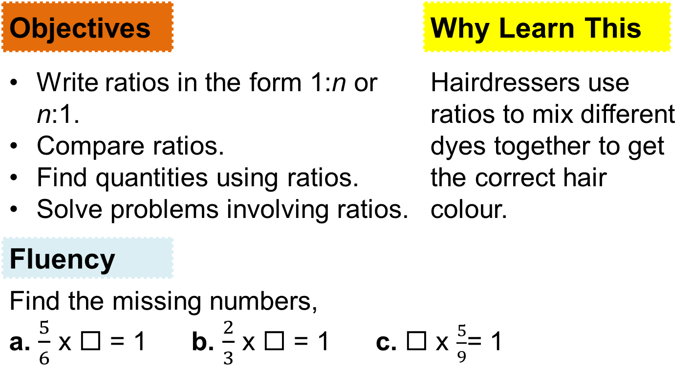
4.2 - Ratios
Page 100
Objectives |  | Why Learn This
Write ratios in the form 1:n or n:1. Compare ratios. Find quantities using ratios. Solve problems involving ratios. |  | Hairdressers use ratios to mix different dyes together to get the correct hair colour.
Fluency
Find the missing numbers, a. $\frac{5}{6}$ x ◻ = 1 b. $\frac{2}{3}$ x ◻ = 1 c. ◻ x $\frac{5}{9}$= 1
ActiveLearn - Homework, practice and support: Higher 4.2

Slide 25

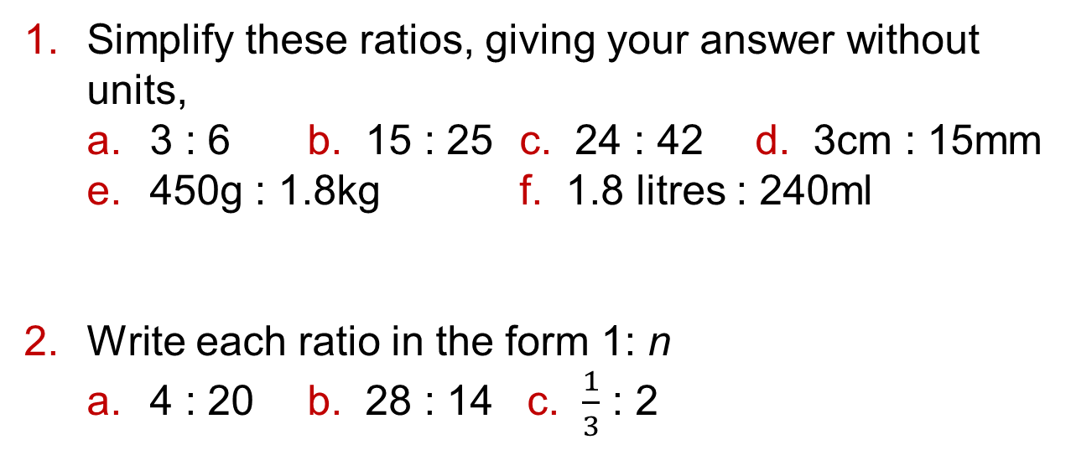
4.2 - Ratios
Page 101
Simplify these ratios, giving your answer without units,
  3 : 6 b. 15 : 25 c. 24 : 42 d. 3cm : 15mm
  450g : 1.8kg f. 1.8 litres : 240ml
Write each ratio in the form 1: n
  4 : 20 b. 28 : 14 c. $\frac{1}{3}$ : 2
Warm Up
Q1 hint – Give answers for d to f without units.
Q2a hint – The question tells you to make the left side of the ratio equal to 1.
Divide both sides of the ratio by
the number on the left.
The number on the right may not be a whole number.

Slide 26
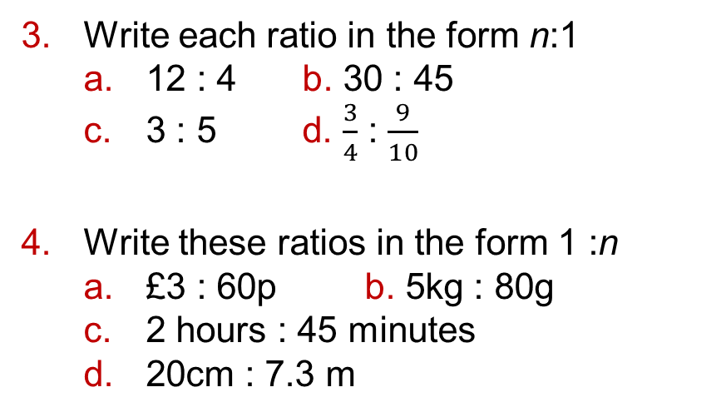
4.2 - Ratios
Page 101
Key Point 3
You can compare ratios by writing them as unit ratios. In a unit ratio, one of the numbers is 1.
Write each ratio in the form n:1
  12 : 4 b. 30 : 45
  3 : 5 d. $\frac{3}{4}$ : $\frac{9}{10}$
Write these ratios in the form 1 :n
  £3 : 60p b. 5kg : 80g
  2 hours : 45 minutes
  20cm : 7.3 m
Q3d hint – Make the right-hand
Q4 hint – If the answer is not an integer, you can use fractions or decimals. Choose whichever is most accurate.

Slide 27
4.2 - Ratios
Page 101
Reasoning In a school there are 52 teachers and 598 students,
  Write the student : teacher ratio in the form of n:1.
  Another school has 85 teachers and 1020 students,
  Which school has larger number of teachers per student?
Problem-solving Julie and Hammad each make a glass of orange squash. Julie uses 42 ml of squash and 210 ml of water. Hammad uses 30 ml of squash and 170 ml of water.
Who has made their drink stronger?
Q6 hint – Write the ratios in the form of 1:n

Slide 28

4.2 - Ratios
Page 101
Reasoning Archie and Ben share some money in the ratio 7:11. Ben gets £132. How much money does Archie get?
To make a tough adhesive, Paul mixes 5 parts of resin with 2 parts of hardener,
  Write down the ratio of resin to hardener.
  To fix a birdbath, Paul uses 9g of hardener. How many grams of resin does he use?
  On another project, Paul used 12 g of resin. How much hardener did he use?
Q7 hint –

Slide 29
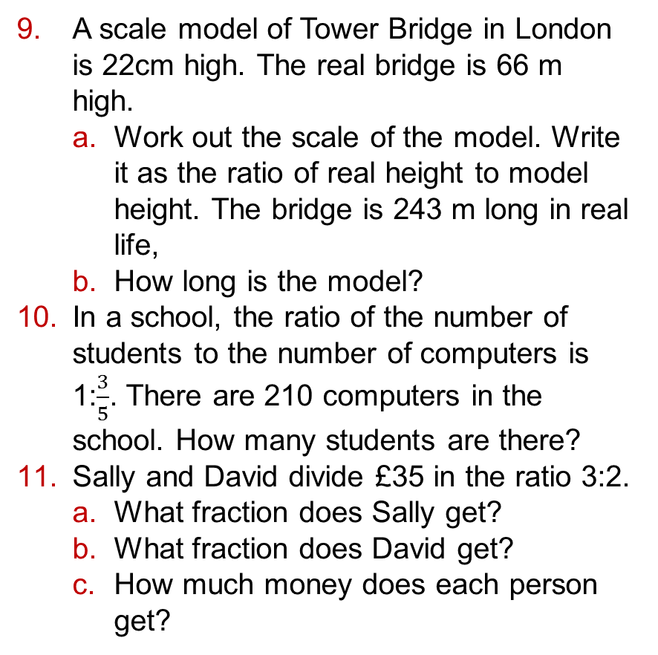
4.2 - Ratios
Page 102
A scale model of Tower Bridge in London is 22cm high. The real bridge is 66 m high.
  Work out the scale of the model. Write it as the ratio of real height to model height. The bridge is 243 m long in real life,
  How long is the model?
In a school, the ratio of the number of students to the number of computers is 1:$\frac{3}{5}$. There are 210 computers in the school. How many students are there?
Sally and David divide £35 in the ratio 3:2.
  What fraction does Sally get?
  What fraction does David get?
  How much money does each person get?

Slide 30
4.2 - Ratios
Page 102
Example 2
Share £126 between Lu
and Katie in the ratio of 2:5.
2 + 5 = 7 parts
1 part = £126 ÷ 7 = £18
Lu: 2 x £18 = £36
Katie: 5 = £18 = £90
Check: £36 + £90 = £126✓
Find out how many parts there are in total.
Find out how much one part is worth.
Find 2 parts and 5 parts.

Slide 31
4.2 - Ratios
Page 102
Share 465 building blocks between Benji and Freddie in the ratio 7 : 8.
How many blocks does each person get?
Discussion Which is easier, working out fractions first (like in Q11) or using the method in the worked example? Why?
James and Freya share a piece of fabric 20.4 m long in the ratio 3:2.
What length of fabric does Freya get?
Share each quantity in the given ratio.
  £374 in the ratio 2 : 4 : 5
  £46.70 in the ratio 1 : 3 : 4
  87m in the ratio 3 : 1 : 6
  774kg in the ratio 2 : 7 : 3
  Discussion How should you round your answer when working with money? What about with kg?

Slide 32
4.2 - Ratios
Page 102
15 – Exam-Style Questions
Talil is going lo make some concrete mix.
He needs to mix cement, sand and gravel in the ratio 1 : 3 : 5 by weight.
Talil wants to make 180 kg of concrete mix. Talil has
  15 kg of cement 85 kg of sand
  100 kg of gravel.
Does Talil have enough cement, sand and gravel to make the concrete mix?
(4 marks)
Nov 2012, Q13, 1MA0/1H
Exam hint
Work out how much of each ingredient is needed for ISO kg of concrete mix and comment on each ingredient to say if there is enough.

Slide 33

4.2 - Ratios
Page 103
Write each ratio as a whole number ratio in its simplest form,
  20 : 36.5 b. 71 : 120.5
  20.1 : 46.9 d. 90.3 : 6.02
Q16a hint - Multiply first by powers of ten to make both sides of the ratio whole numbers, then simplify.

Slide 34
4.2 - Ratios
Page 103
Real / Reasoning Ben wants to make some turquoise paint. He is going to mix blue, green and yellow paint in the ratio 2.4 : 1.5 : 0.1.
Copy and complete the table to show how much of each colour Ben needs to make the paint quantities shown.
Size | Blue | Green | Yellow
1 litre
2.5 litres
5.5 Litres
Q17 hint - Write the ratio in whole numbers first, then share the amount of paint in the new ratio.

Slide 35
4.3 – Ratio and Proportion
Page 103
Objectives |  | Why Learn This
Convert between currencies and measures. Recognise and use direct proportion. Solve problems involving ratios and proportion. |  | When you are on holiday, it is useful to be able to convert between currencies, to work out the price you would pay for an item back home.
Fluency
A wildlife sanctuary has 7 adult tigers and 2 tiger cubs. What proportion of the tigers are cubs?
ActiveLearn - Homework, practice and support: Higher 4.3

Slide 36
4.3 – Ratio and Proportion
Page 103
Warm Up
Which of these ratios are equivalent?
The exchange rate between pounds and Australian dollars (AUD) is £1 = $1.80.
  Convert £200 to dollars.
  Convert $756 to pounds.
Problem-solving Kirsty buys a pair of jeans in England for £52.
On holiday in Hong Kong, she sees the same jeans on sale for HK$620. The exchange rate is £1 = HK$12.40.
Where are the jeans cheaper?
1:3 2:5 4:7
6:15 5:7.5

Slide 37
4.3 – Ratio and Proportion
Page 103
Reasoning Ned and Adrian both go out for a bicycle ride one day. Ned rides for 23.5 miles. Adrian rides for 41 km. 5 miles = 8 km.
  Write the ratio of miles to kilometres in the form 1: n.
  Work out who has ridden further and by how much.
Reasoning Craig is painting his room orange.
He buys a tin of paint with red and yellow in the ratio 5:4. Another tin of paint has yellow and red in the ratio 16:20. Are the two tins of paint the same shade of orange?
Explain your answer.
Q5 hint - Are the proportions of red and yellow paint the same in both tins?

Slide 38
4.3 – Ratio and Proportion
Page 104
Problem-solving Joe is paid £63 for 12 hours’ work in a supermarket,
  What fraction of this is Joe paid for 7 hours' work?
  Work out how much is he paid for 7 hours' work.
  Joe is paid more than the minimum wage for his age.
  How old is he? How specific can you be?
Age | 21 & over | 18 to 20 | Under 18 | Apprentice
Current minimum wage (2014) | £6.50 | £5.13 | £3.79 | £2.73

Slide 39
4.3 – Ratio and Proportion
Page 104
In a cake, the ratio of butter, b, to sugar, s, is 3:4 Copy and complete.
s = b x ◻ = ◻b b = s x ◻ = ◻s
Reasoning Caroline makes spicy beetroot chutney.
For every 500g of beetroot, she uses 2 hot chillies,
  Write a formula for c, the number of chillies used with n grams of beetroot,
  Caroline has 2.75 kg of beetroot. How many chillies does she need?
  Caroline wants to make the chutney much spicier, so she doubles the number of chillies,
  Write a formula for the new recipe.
Q7 hint –
b : s s : b
3 : 4 4 : 3
1 : ◻ 1 : ◻

Slide 40
4.3 – Ratio and Proportion
Page 104
Key Point 4
When two quantities are in direct proportion, as one is multiplied by a number, n, so is the other.
Are these pairs of quantities in direct proportion?
  10 bread rolls cost £1.60,15 rolls cost £2.24
  3 bitcoins cost £10.80, 7 bitcoins cost £25.20
  5 people weigh 391 kg, 9 people weigh 767 kg.

Slide 41
4.3 – Ratio and Proportion
Page 104
STEM / Modelling In a science experiment, Kishan measures how far a spring extends when he adds different weights to it. The table shows his results.
Are the weight and extension in direct proportion?
The cost of ribbon is directly proportional to its length. A 3.5 m piece of ribbon costs £2.38. Work out the cost of 8 m of this ribbon.
Weight (w) | 1N | 2N | 3N | 4N | 5N
Extension (e) | 12 mm | 24 mm | 36 mm | 48 mm | 60 mm

Slide 42
4.3 – Ratio and Proportion
Page 104
The table gives readings P and Q in a science experiment,
  Are P and Q in direct proportion? Explain,
  Write a formula for Q in terms of P.
  Write the ratio P:Q in its simplest form.
The values of A and 8 are in direct proportion. Work out the missing values P, Q, R and 5..
P | 5 | 10 | 14
Q | 7.5 | 15 | 21
Value of A | 32 | P | Q | 20 | 72
Value of B | 20 | 30 | 35 | R | S

Slide 43
4.3 – Ratio and Proportion
Page 105
Problem-solving The length of the shadow of an object is directly proportional to the height of the object.
A lamp post 4.8 m tall has a shadow 2.1 m long. Work out the height of a nearby bus stop with a shadow 1.05 m long.
15 – Exam-Style Questions
Margaret is in Switzerland.
The local supermarket sells boxes
of Reblochon cheese.
Each box of Reblochon cheese
costs 3.10 Swiss francs. It weighs 160 g.
In England, a box of Reblochon cheese costs £13.55 per kg. The exchange rate is £ 1 = 1.65 Swiss francs.
Work out whether Reblochon cheese is better value for money in Switzerland or England. (4 marks)
Nov 2010, Q5, 5MB1H/01
3.10 Swiss Francs
160g
Exam hint
You only need to convert one of the prices into the other currency, not both, before you look at the weight.

Slide 44
4.4 – Percentages
Page 103
Objectives |  | Why Learn This
Work out Percentage increases and decreases. Solve real-life problems involving percentages. |  | Percentage change calculations help us to compare the cost of living, to see if we are spending more or less of our money on basic necessities from one year to the next.
Fluency
Find these percentages of £50. a. 10% b. 20% c. 5%
ActiveLearn - Homework, practice and support: Higher 4.4

Slide 45
4.4 – Percentages
Page 105
Write down the single number you can
multiply by to work out an increase of
  5% b. 30% c. 5%
Write down the single number you can
multiply by to work out
a decrease of
  25% b. 10%
  6%
Warm Up

Slide 46
4.4 – Percentages
Page 105
Karen gets a gas bill. The cost of the gas before the VAT was added was £361.20.
VAT is charged at 5% on domestic fuel bills. What was the cost of the gas bill, including VAT?
A holiday costing £875 in the brochure is reduced by 12%. How much does the holiday cost now?
Q3 communication hint - Value Added Tax (VAT) is charged at 20% on most goods and services. Domestic fuel bills have a lower VAT rate of 5%.

Slide 47
4.4 – Percentages
Page 105
4 – Exam-Style Questions
Petra booked a family holiday.
The total cost of the holiday was £3500 plus VAT at 20%.
Petra paid £900 of the total cost when she booked her holiday.
She paid the rest of the total cost in 6 equal monthly payments.
Work out the amount of each monthly payment. (5 marks)
June, 2013 Q7, 5MB3H/01
Exam hint
Read one sentence at a time and decide what calculation you need to do.

Slide 48
4.4 – Percentages
Page 106
Reasoning Curtis buys a car for £9600. The value of the car depreciates by 20% each year.
Work out the value of the car after
  1 year b. 2 years.
Q6 communication hint - Depreciates means loses value.
Q6 hint - The value at the end of year 1 depreciates another 20% in year 2.
Key Point 5
Simple interest is the interest calculated only on the original amount invested. It is the same each year.

Slide 49
4.4 – Percentages
Page 106
Finance
  Work out the amount of simple interest earned in one year for each of these investments.
    £1500 at 2% per year.
    £700 at 8% per year,
  Martina invests £14 500 for 3 years at 6.75% simple interest.
  How much is the investment worth at the end of the 3 years?
Q7 hint - Work out the amount of interest she earns each year and multiply by 3.

Slide 50
4.4 – Percentages
Page 106
Finance / Problem-solving Income tax is paid on any
money you earn over your personal tax allowance.
  The personal tax allowance is currently set at £10000.
  Above this amount, tax is paid at different rates, depending on how much you earn. The table shows the rates for 2014/15.
  Work out the amount of income tax each of these people paid in the 2014/15 tax year.
    Ella earns £26500 per annum. b. Sammy earns £28760 p.a.
    Antony earns £47 000 p.a. d. Pippa earns £73 850 p.a.
Tax Rate | Taxable income above your personal allowance
Basic rate 20% | £0 to £31865
Higher rate 40% | £31 866 to £150000
Q8 hint - Subtract the personal tax allowance before working out the tax owed.
Q8 communication hint - Your income means the amount of money you earn or are paid, and 'per annum' (abbreviated to p.a.) means each year.

Slide 51
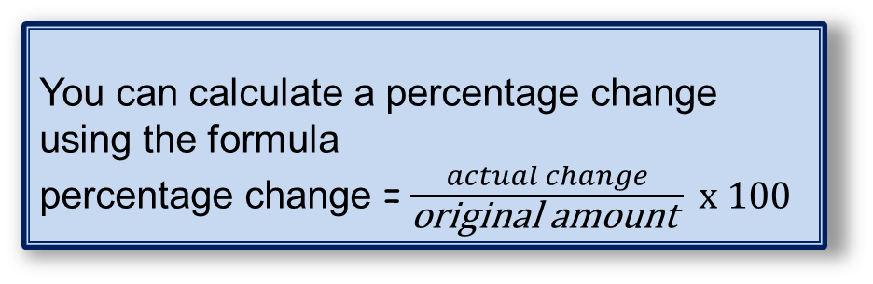
4.4 – Percentages
Page 106
Key Point 6
You can calculate a percentage change using the formula
percentage change =$\frac{actual change}{\text{original} \text{amount} } x 100$
Finance Inder invests £3200. When her investment matures, she receives £3328.
  What was the actual increase?
  Work out the percentage increase in her investment.
In 2014, the Croftshire County Council raised £18.64 million in council tax. In 2004, they raised £17.18 million. What was the percentage increase over the decade?

Slide 52
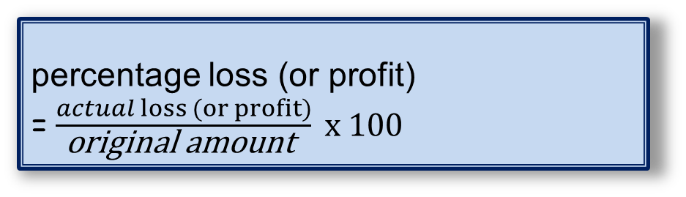
4.4 – Percentages
Page 106
Reena bought a jacket for £45. Six months later, she sold it for £34.65.
What was her percentage loss?
Guy spent £11.40 buying ingredients to make cupcakes. He sold all the cakes for a total of £39.90.
What percentage profit did Gary make?
Key Point 7
percentage loss (or profit) =$\frac{actual loss (or profit)}{\text{original} \text{amount} } x 100$
Q12 strategy hint - When you are working out profits, remember to subtract any costs first.

Slide 53

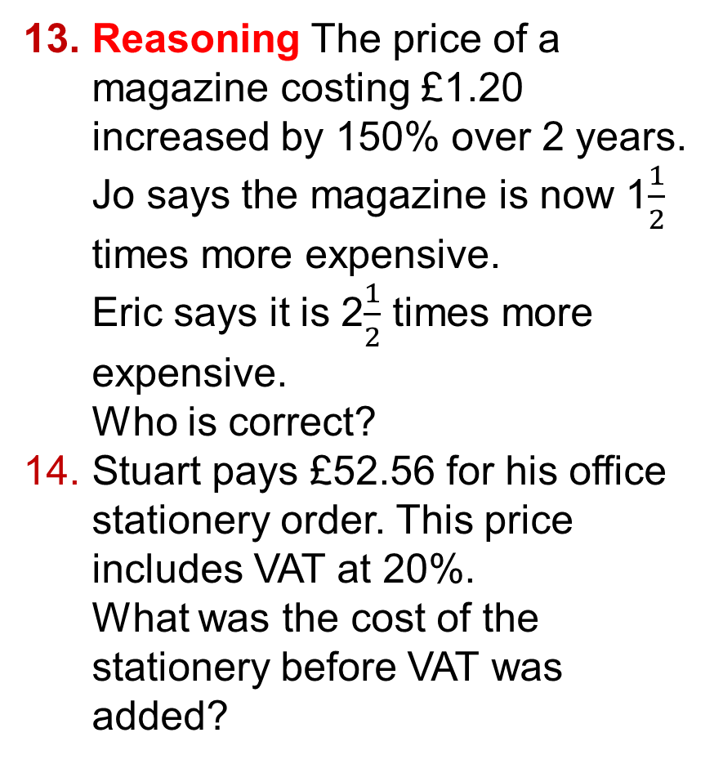
4.4 – Percentages
Page 107
Reasoning The price of a magazine costing £1.20 increased by 150% over 2 years.
Jo says the magazine is now 1$\frac{1}{2}$ times more expensive.
Eric says it is 2$\frac{1}{2}$ times more expensive.
Who is correct?
Stuart pays £52.56 for his office stationery order. This price includes VAT at 20%.
What was the cost of the stationery before VAT was added?

Slide 54
4.4 – Percentages
Page 106
Key Point 8
You can use inverse operations to find the original amount after a percentage increase or decrease.
Example 3
In one year, the value of a car dropped by 12% to £9240. How much was the car worth at the start of the year?
100% - 12% = 88% = 0.88
Original number 9240
9240 10 500
The car was worth £10 500 at the start of the year.
X0.88
÷0.88
Draw a function
machine

Slide 55
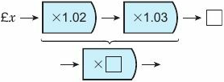
4.4 – Percentages
Page 107
The cost of living increased by 2% one year.
The next year it increased by 3%.
Copy and complete the calculation to work out the total percentage increase over these two years.

Slide 56
4.4 – Percentages
Page 107
Problem-solving Manjit bought a house. The value of her house went up by 5% in the first year. In the second year, the value went up by 2%. At the end of the two years, her house was worth £171360.
  What was the total percentage increase? Do not round your answer,
  Work out the amount Manjit paid for her house.
Reasoning a. Show that applying a 20% increase followed by a 20% decrease is the same as a 4% decrease overall.
  Will the final amount be the same or different if you apply the decrease first, then the increase?

Slide 57
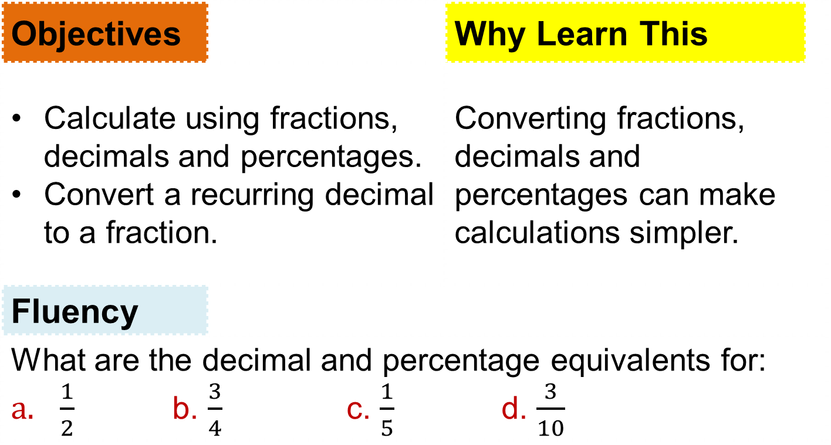
4.5 – Fractions, Decimals and Percentages
Page 108
Objectives |  | Why Learn This
Calculate using fractions, decimals and percentages. Convert a recurring decimal to a fraction. |  | Converting fractions, decimals and percentages can make calculations simpler.
Fluency
What are the decimal and percentage equivalents for: $\frac{1}{2}$ b. $\frac{3}{4}$ c. $\frac{1}{5}$ d. $\frac{3}{10}$
ActiveLearn - Homework, practice and support: Higher 4.5

Slide 58
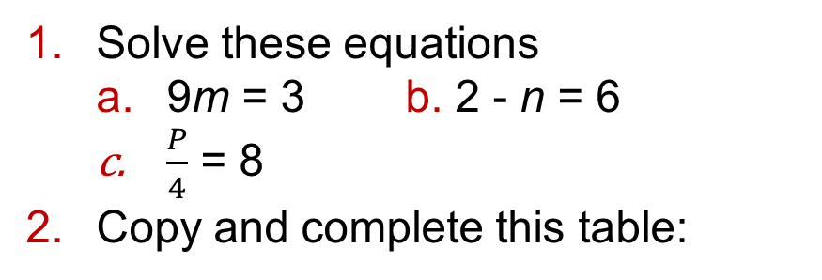
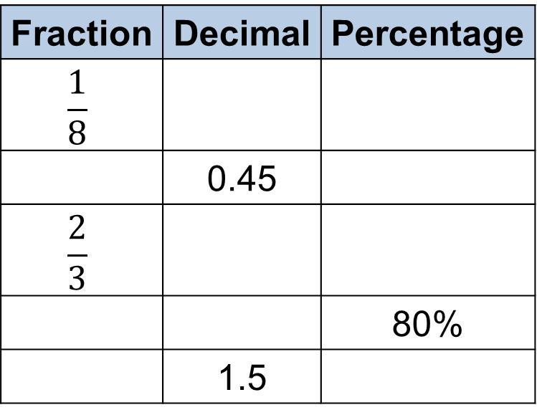
4.5 – Fractions, Decimals and Percentages
Page 108
Solve these equations
  9m = 3 b. 2 - n = 6
  $\frac{P}{4}$ = 8
Copy and complete this table:
Warm Up
Fraction | Decimal | Percentage
$$\frac{1}{8}$$
 | 0.45
$$\frac{2}{3}$$
 |  | 80%
 | 1.5

Slide 59
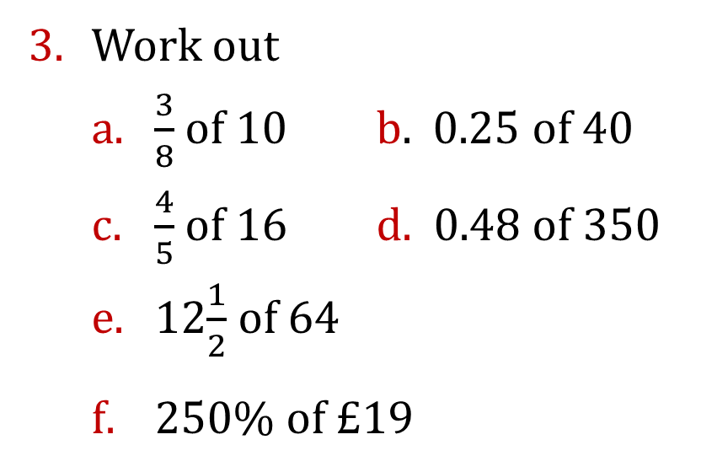
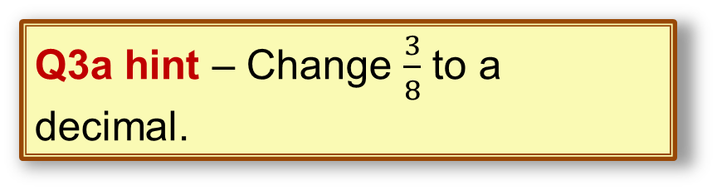
4.5 – Fractions, Decimals and Percentages
Page 108
Work out
  $\frac{3}{8}$ of 10 b. 0.25 of 40
  $\frac{4}{5}$ of 16 d. 0.48 of 350
  12$\frac{1}{2}$ of 64
  250% of £19
Warm Up
Q3a hint – Change $\frac{3}{8}$ to a decimal.
Q3b hint – Change 0.25 to a fraction.

Slide 60
4.5 – Fractions, Decimals and Percentages
Page 108
Reasoning A restaurant manager bought a case of 12 bottles of sparkling water.
He paid 90p per bottle.
He sold 4 of the bottles for £2.10 per bottle and the rest of the case for £2.40 per bottle,
  How much profit did he make?
  Express this profit as a percentage of the total cost price.

Slide 61


4.5 – Fractions, Decimals and Percentages
Page 108
5 – Exam-Style Questions
Mr. Mason asks 240 Year 11 students what they want to do next year.
15% of the students want to go to college, $\frac{3}{4}$ of the students want to stay at school.
The rest of the students do not know.
Work out the number of students who do not know. (4 marks)
June 2013, Q2, IMAQ/1HJ
Q5 strategy hint –
You could draw a
diagram.

Slide 62
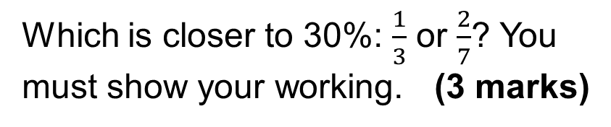

4.5 – Fractions, Decimals and Percentages
Page 108
6 – Exam-Style Questions
A farmer uses 1.8 out of every 5 acres of land to grow crops.
He grows corn on $\frac{5}{6}$ of the land he uses for crops.
What percentage of the total area of his land does he use to grow corn?
(3 marks)
7 – Exam-Style Questions
Which is closer to 30%: $\frac{1}{3}$ or $\frac{2}{7}$? You must show your working. (3 marks)

Slide 63
4.5 – Fractions, Decimals and Percentages
Page 109
Problem-solving The table shows the number of days, absence for Year 9 students in each school term over 2 years.
Write three sentences comparing the absences in the 2 years. Use fractions, decimals, percentages, ratio or proportion.
 | Term 1 | Term 2 | Term 3
Year 9 (2012/2013) | 46 | 76 | 24
Year 9 (2013/2014) | 28 | 64 | 36
Q8 hint - Choose calculations that will help you to compare.

Slide 64
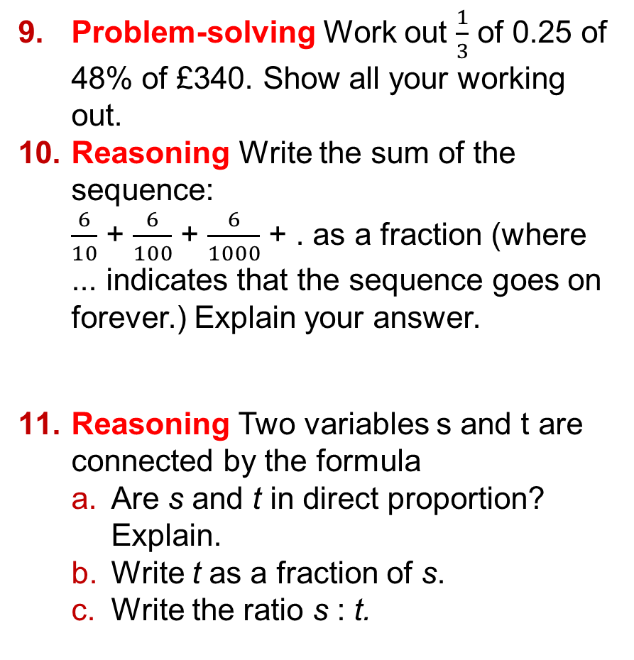
4.5 – Fractions, Decimals and Percentages
Page 109
Problem-solving Work out $\frac{1}{3}$ of 0.25 of 48% of £340. Show all your working out.
Reasoning Write the sum of the sequence:
$\frac{6}{10}$ + $\frac{6}{100}$ + $\frac{6}{1000}$ + . as a fraction (where ... indicates that the sequence goes on forever.) Explain your answer.
Reasoning Two variables s and t are connected by the formula
  Are s and t in direct proportion? Explain.
  Write t as a fraction of s.
  Write the ratio s : t.
Q10 hint - Write the fractions as decimals.

Slide 65
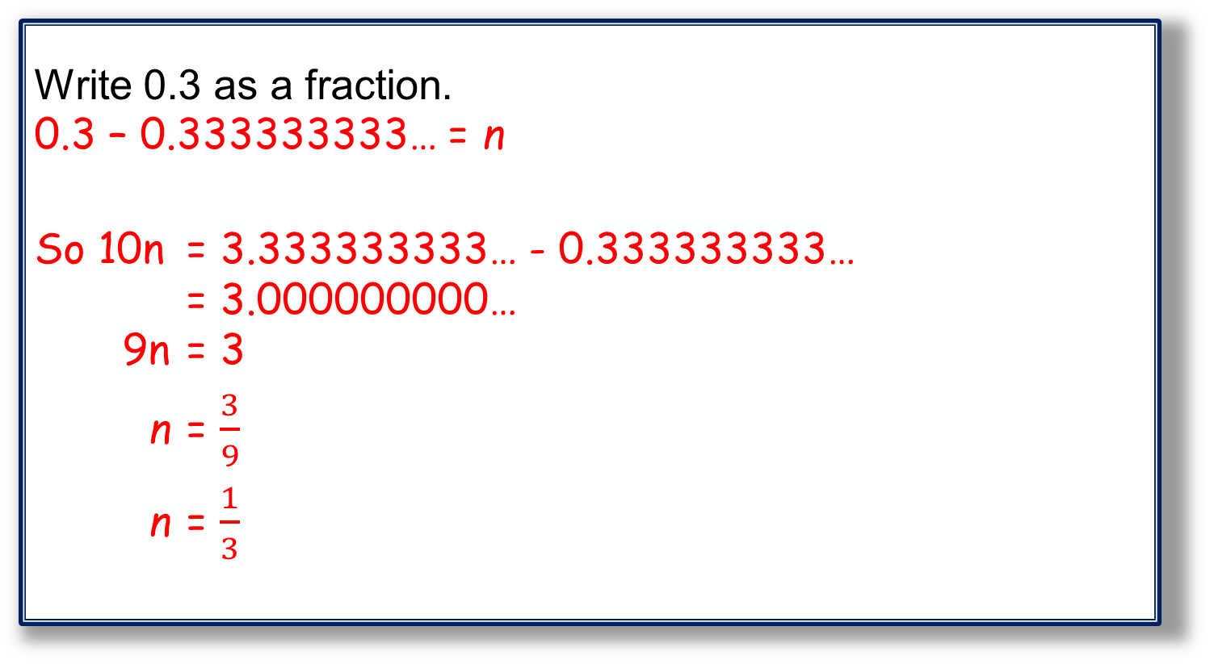
4.5 – Fractions, Decimals and Percentages
Page 109
Example 4
Write 0.3 as a fraction.
0.3 – 0.333333333… = n
So 10n = 3.333333333… - 0.333333333…
= 3.000000000…
9n = 3
n = $\frac{3}{9}$
n = $\frac{1}{3}$
Call the recurring decimal n.
Multiply the recurring decimal by 10 to shift the sequence one place left.
Subtract the value of n from the value of 10n. This makes all the numbers after the decimal point 0.
Solve the equation
Simplify the fraction if possible
Key Point 9
All recurring decimals can be written and exact fractions.

Slide 66

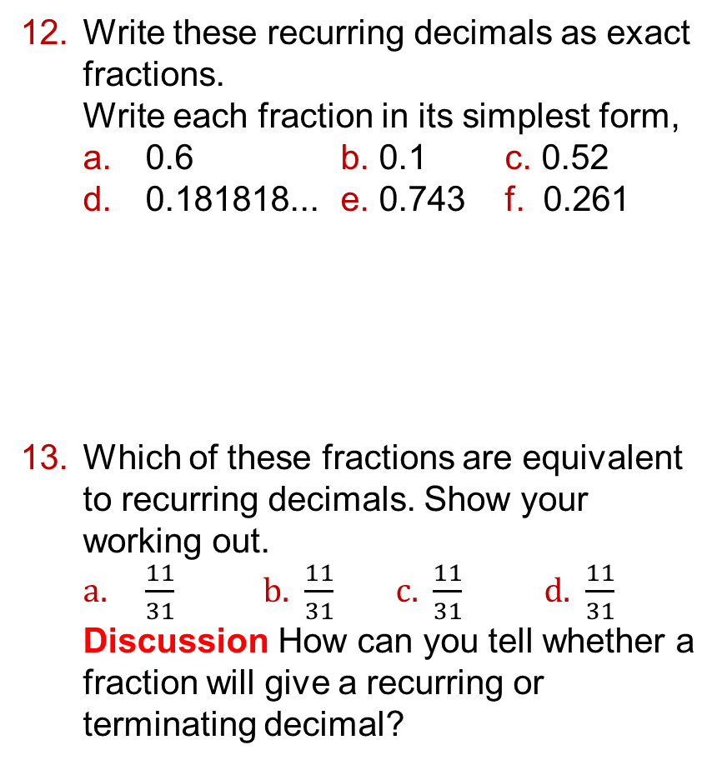
4.5 – Fractions, Decimals and Percentages
Page 109
Write these recurring decimals as exact fractions.
Write each fraction in its simplest form,
  0.6 b. 0.1 c. 0.52
  0.181818... e. 0.743 f. 0.261
Which of these fractions are equivalent to recurring decimals. Show your working out.
  $\frac{11}{31}$ b. $\frac{11}{31}$ c. $\frac{11}{31}$ d. $\frac{11}{31}$
  Discussion How can you tell whether a fraction will give a recurring or terminating decimal?
Q12 strategy hint - Multiply by a power of ten. If 1 decimal place recurs, multiply by 10.
If 2 decimal places recur, multiply by 100.
If 3 decimal places recur, multiply by 1000.

Slide 67
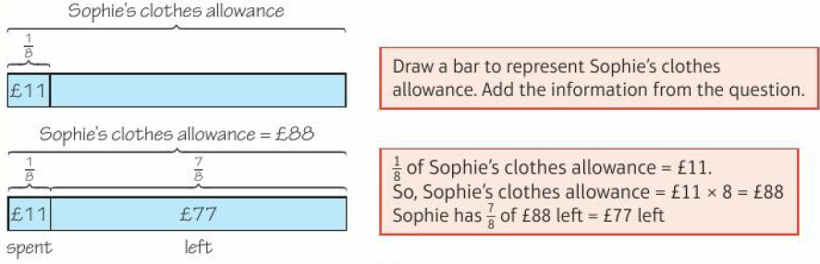
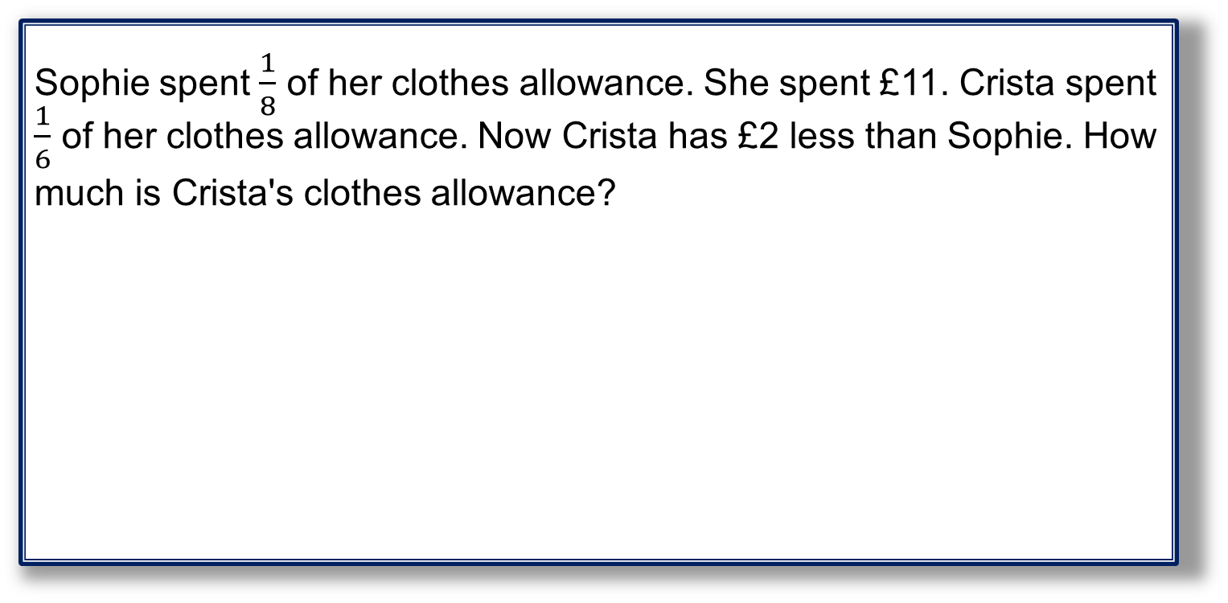
4 – Problem Solving
Page 110
Objectives
Use bar models to help you solve problems.
Example 5
Sophie spent $\frac{1}{8}$ of her clothes allowance. She spent £11. Crista spent $\frac{1}{6}$ of her clothes allowance. Now Crista has £2 less than Sophie. How much is Crista's clothes allowance?

Slide 68
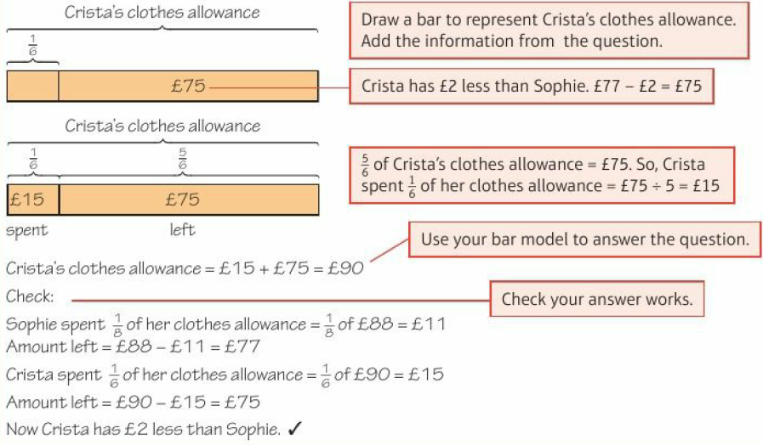
4 – Problem Solving
Page 110
Example 5 - continued

Slide 69

4.5 – Fractions, Decimals and Percentages
Page 110
This Christmas, Mr. Smith spent times his budget for presents. He spent £405. Mrs. Smith spent l| times her budget for presents. She spent £5 less than Mr. Smith spent,
  How much was Mr. and Mrs. Smith's total budget for presents?
  How much did they overspend?
Q1 hint – Mr. Smith's spending = £__

Slide 70

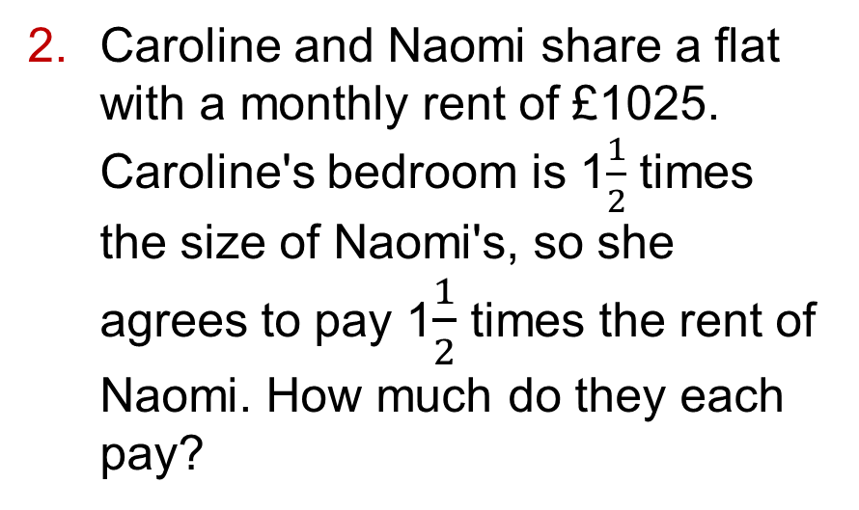
4.5 – Fractions, Decimals and Percentages
Page 110
Caroline and Naomi share a flat with a monthly rent of £1025. Caroline's bedroom is 1$\frac{1}{2}$ times the size of Naomi's, so she agrees to pay 1$\frac{1}{2}$ times the rent of Naomi. How much do they each pay?
Q2 hint – £__

Slide 71
4.5 – Fractions, Decimals and Percentages
Page 111
A petting zoo has rabbits, goats and llamas in the ratio 6:3:2.The zoo has 8 more rabbits than llamas. How many goats does it have?
Jamie invests some money. In the first year it increases to 110% of its original value.
He spends 20% of the profit on a cricket bat and y of the remainder on a cricket jumper. He is left with £140 profit. How much did Jamie invest?
Q3 hint - Draw a bar model showing the ratio 6:3:2. Compare rabbits and llamas. How many sections represent 8 rabbits?

Slide 72
4.5 – Fractions, Decimals and Percentages
Page 111
Amateur boxers can only fight other boxers in the same weight class.
The table shows three of the weight classes. Two amateur boxers have weights in the ratio 2.5:3. Their total weight is 165 kg.
Can the boxers fight each other?
Explain.
Weight Class | Boxer’s weight (kg)
Heavyweight | 81-91
Light Heavyweight | 75-81
Middleweight | 69 - 75
Q4 hint - Draw a bar to represent the total weight. Split the bar into 0.5 sections. One section = _____ kg

Slide 73
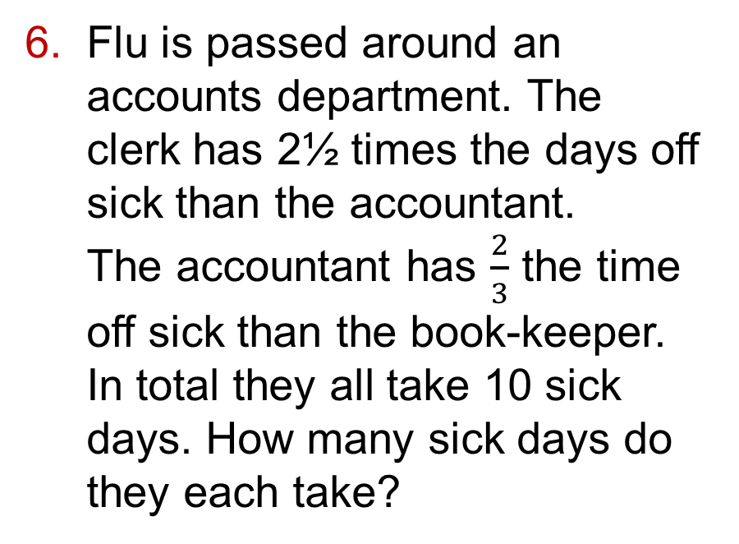
4.5 – Fractions, Decimals and Percentages
Page 111
Flu is passed around an accounts department. The clerk has 2½ times the days off sick than the accountant.
The accountant has $\frac{2}{3}$ the time off sick than the book-keeper. In total they all take 10 sick days. How many sick days do they each take?
Q6 hint - Draw the accountant's section of a bar first. Label it A. Next draw the clerk’s section. Label it C. Be very careful when drawing the book-keeper's section, B.

Slide 74
4.5 – Fractions, Decimals and Percentages
Page 111
8 adults, 6 children and 2 seniors swim lengths at a swimming pool session. The mean number of lengths swum by the adults is 40, the mean swum by the children is 7 and the mean swum by the seniors is 35.
Work out the mean number of lengths swum by everyone in the session.
Reflect Look back at the exam-style questions in lessons 4.4 and 4.5. How could you answer these questions using bar models?
Is drawing bar models a strategy you would use again to solve problems?
Q7 hint - Draw a bar model to represent all the swimmers. 8 adults swum a mean of 40 lengths. How many lengths did they swim altogether?

Slide 75


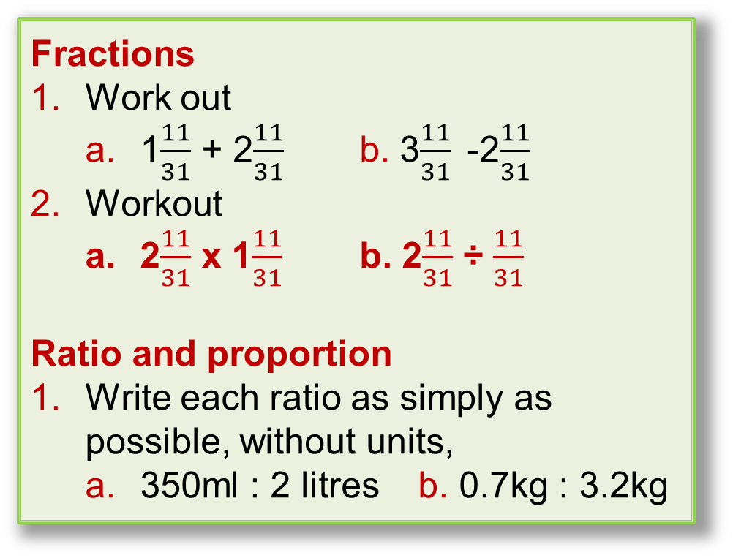
4 – Check up
Page 111
2. Check up
Log how you did on your Student Progression Chart
Fractions
Work out
  1$\frac{11}{31}$ + 2$\frac{11}{31}$ b. 3$\frac{11}{31}$-2$\frac{11}{31}$
Workout
  2$\frac{11}{31}$ x 1$\frac{11}{31}$ b. 2$\frac{11}{31}$ ÷ $\frac{11}{31}$
Ratio and proportion
Write each ratio as simply as possible, without units,
  350ml : 2 litres b. 0.7kg : 3.2kg

Slide 76
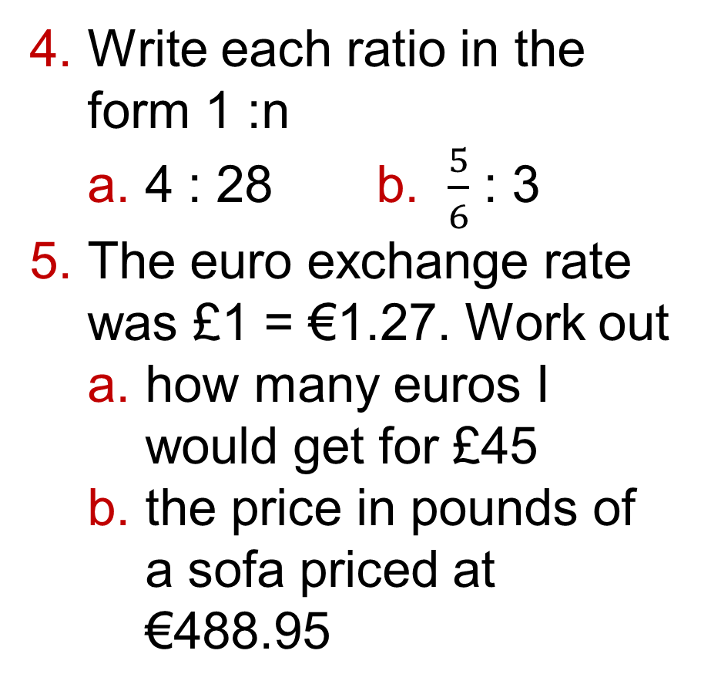
4 – Check up
Page 111
Write each ratio in the form 1 :n
  4 : 28 b. $\frac{5}{6}$ : 3
The euro exchange rate was £1 = €1.27. Work out
  how many euros I would get for £45
  the price in pounds of a sofa priced at €488.95

Slide 77

4 – Check up
Page 112
Reasoning Ellis makes some biscuits. For every 200g of flour he uses, he needs 75g of butter.
  Write a ratio for the amount of flour to the amount of butter.
  Write a formula for f, the amount of flour in terms of the amount of butter b.
  Ellis makes 24 biscuits using 300g of flour.
  How many biscuits can he make with 375g of butter.
Share £132 in the ratio 3:2:1

Slide 78
4 – Check up
Page 112
Fractions, decimals and percentages
Work out the final amount when
  £450 is increased by 7.5%
  877.2 kg is decreased by 3.2%
Simon scores 68 marks in his second maths test. In his first maths test he scored 85 marks. What is the percentage decrease in Simon's score?
The price of a laptop increases by 35%. The new price is £972.
What was the original price?

Slide 79
4 – Check up
Page 112
Barbara invests £14,000.
In the first year, she earns 5.9% interest.
In the second year, she earns 3.2% interest,
  What was the total percentage increase over the 2 years?
  How much money does she have after 2 years?
Reflect
How sure are you of your answers? Were you mostly
Just guessing ☹ Feeling doubtful 😐 Confident ☺
What next? Use your results to decide whether to strengthen or extend your learning.

Slide 80
4 – Check up
Page 112
* Challenge
Find the cube root of the reciprocal of the square root of the reciprocal of 64. Write a problem similar to this.
Make sure you know the answer.

Slide 81
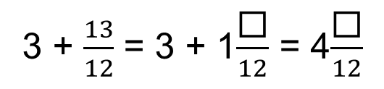


4 – Strengthen
Page 112
Fractions
Work out
  $\frac{1}{5}$ ÷ $\frac{1}{4}$. b. $\frac{1}{3}$÷ $\frac{3}{4}$ c. $\frac{4}{5}$ ÷ $\frac{3}{10}$
  $\frac{3}{8}$ ÷ $\frac{1}{5}$ e. $\frac{9}{10}$ ÷ $\frac{2}{5}$ f. $\frac{7}{12}$ ÷ $\frac{5}{6}$
Giving your answers as mixed numbers, work out
  3 + $\frac{13}{12}$. b. $\frac{7}{3}$ + 4
  $\frac{21}{9}$ + 5 d. 2 + $\frac{48}{15}$
Q1 hint - $\frac{1}{5}$ ÷ $\frac{1}{4}$ = $\frac{1}{5}$ x ◻
Q2a hint – change the improper fraction
to a mixed number:
3 + $\frac{13}{12}$ = 3 + 1$\frac{\text{◻}}{12}$ = 4$\frac{\text{◻}}{12}$

Slide 82

4 – Strengthen
Page 113
Fractions
Work out
  2$\frac{1}{3}$ + 3$\frac{3}{4}$ = 5 + $\frac{1}{3}$ + $\frac{3}{4}$ = 5 + $\frac{\text{◻}}{\text{◻}}$
  1$\frac{2}{3}$ + 5$\frac{1}{8}$ c. 2$\frac{4}{5}$ + 1$\frac{2}{9}$
  6$\frac{1}{7}$ + 4$\frac{7}{10}$
Work out these subtractions. Give your answers as mixed numbers.
  6 - 2$\frac{1}{2}$ = $\frac{12}{2}$ - $\frac{\text{◻}}{2}$ b. 5$\frac{1}{4}$ - 2$\frac{3}{8}$
  3$\frac{2}{7}$ - 1$\frac{3}{5}$ d. 4$\frac{3}{8}$ - $\frac{5}{6}$
  2$\frac{1}{10}$ - 1$\frac{7}{8}$
Q4a hint – Write both numbers as halves

Slide 83


4 – Strengthen
Page 113
Fractions
Work out
  1$\frac{4}{5}$ ÷ $\frac{1}{4}$
  2$\frac{1}{3}$ ÷ $\frac{5}{8}$
  2$\frac{4}{5}$ ÷ $\frac{7}{10}$ d. 3$\frac{1}{8}$ ÷ $\frac{5}{12}$
Ratio and proportion
Which of these ratios are in the form
  1 : n? b. n : 1?
Q5a hint – Change the mixed number to an improper fraction. Then use the method in Ql.
A 3 : 1
B 5 : 2
C 2 : 1
D 1 : 7
E 8 : 9

Slide 84

4 – Strengthen
Page 113
Fractions
Write each ratio in the form
    1 : n ii. n : 1
    The first one has been started for you.
    3:15
    1 : n n : 1
    3 : 15 3 : 15
    ÷3 ÷3 ÷15 ÷15
    1 : ◻ ◻ : 1
    8:2 c. 7:56 d. 42:24
  Simplify each of these ratios.
    6.5:4 b. 5:8.5
    2.8:4 d. 5.6:8.8
Q9f strategy hint – Choose a number to multiply by that will give you a whole number on both sides of the ratio.

Slide 85

4 – Strengthen
Page 113
In 2007 the exchange rate from pounds to US dollars was £1 = $2
  How many dollars could you buy for
    £4 ii. £5?
    What calculation did you use to work it out?
  How many pounds could you buy for
    $6 ii. $10?
    What calculation did you use to work it out?
Q4 hint - Work out the multiplier to change inverse operation to change $ to £.

Slide 86

4 – Strengthen
Page 113
Reasoning A and B are in direct proportion.
Fill in the missing values for X and Y in this table.
A | 4 | 8 | Y
B | 9 | X | 45
Q5 hint –

Slide 87
4 – Strengthen
Page 113
Reasoning P and Q are in direct proportion. Find the
missing value in the
table.
Show your working.
Kiran, Lewis, Stephen and Jane are paid in the ratio 2:5:4:7, according to the number of hours they have worked.
Lewis is paid £35.50.
Work out how much money Kiran, Stephen and Jane receive.
P | Q
3 | 5
 | 9
Q7 hint – K : L : S : J
2 : 5 : 4 : 7
◻ : £35.50 : ◻ : ◻

Slide 88
4 – Strengthen
Page 113
Fractions, decimals and percentages
Convert these percentages to decimals,
  104% b. 126.5% c. 98.3%
The price of a theatre ticket increases by 3.5% from £45
  What percentage of £45 will the new price be?
  Write your answer to part a as a decimal.
  Work out the new price.
Q2a hint – 100% + ◻% = ◻%
Q2c hint – ◻ x 45 = ◻

Slide 89

4 – Strengthen
Page 113
The price of a pedicure decreases by 4.2% from £36 on promotion,
  What percentage of £36 will the new price be?
  Write your answer to part a as a decimal,
  Work out the new price.
Work out
  0.75 x 150 g
  $\frac{3}{8}$ of £10
  33.3% of £36
Q6 hint – Use an equivalent fraction, decimal or percentage to make the calculation easier.

Slide 90


4 – Strengthen
Page 113
Betsy invests £3000. When her investment matures, she receives £3135.
  Copy and complete the working to calculate the percentage increase of Betsy’s investment,
  original amount = 3000
  actual change = 3135 - 3000 = 135
  percentage change = $\frac{\text{actual} \text{amount} }{\text{original} \text{amount} }$ x 100 = $\frac{135}{3000}$ x 100 = ◻%
  Check your answer by increasing £3000 by the percentage you calculated. Do you get £3135?
Q4 hint – Draw this
information as a bar
model

Slide 91

4 – Strengthen
Page 113
Work out the percentage loss made on each of these
items. For each part copy and complete the following working. Check your answers,
  original amount = $\frac{\text{actual} \text{change}}{\text{original} \text{amount} }$ x 100 = $\frac{\text{◻}}{\text{◻}}$ x 100 = ◻%
  Bought for £8, sold for £5.75
  Bought for £145, sold for £120
  Bought for £615, sold for £500

Slide 92
4 – Strengthen
Page 115
The price of a computer game after
  28% increase is £13.44 a What decimal number do you multiply by to increase a value by 28%?
  Draw a function machine for this calculation,
  Work backwards through the function machine to find the original price.
Q7b hint –
Original price: → x ◻ → £13.44
Work backwards: ◻ ← ÷ ◻ ← £13.44

Slide 93
4 – Strengthen
Page 115
Find the original price of
  a sofa that costs £585 after a 25% discount
  a house priced at £192 030 after its value rose by 3.8
Carol put £5000 in a savings account for 2 years.
The first year she earned 2.5% interest.
The second year she earned 3.1% interest.
  Write a calculation to find the amount of money Carol had at the end of the first year,
  Multiply your calculation from part a by 1.031 to find the amount in the account after 2 years.
Q8 hint – Use the method from Q7.

Slide 94

4 – Extend
Page 115
Problem-solving Amanda, Chen and Mark shared some money in the ratio 2:4:9.
Mark got £84 more than Amanda.
How much money did Chen get?
Workout $\frac{\frac{2}{5}+\frac{3}{8}}{1\frac{5}{9}}$
A photocopier increases the sides of a square in the ratio 2:3. What percentage increase is this?

Slide 95

4 – Extend
Page 115
Reasoning The diagram shows a rectangle ABCD.
AB is twice the length of BC.
E is the midpoint of AB.
F is the midpoint of BC.
Work out the area of each of these triangles Give your answer as a fraction of the rectangle,
  ADE b. BEF
  CDF d. DEF

Slide 96


4 – Extend
Page 115
Problem-solving The diagram shows three identical shapes. A, B and C.
$\frac{11}{31}$ of shape A is shaded.
$\frac{11}{31}$ of shape C is shaded.
What fraction of shape B is shaded?

Slide 97
4 – Extend
Page 115
Finance / Reasoning Gareth sells cupcakes.
He adds 40% profit to the cost price.
He sells the cupcakes for £1.68 each.
He wants to increase his profit to 60% of the cost price.
How much should he sell each cupcake for.
Problem-solving In a company, 65% of the workers are female. 40% of the women drive to work.
50% of the men drive to work.
What percentage of the company's employees drive to work?

Slide 98

4 – Extend
Page 116
Here is some information about a class.
  Write down the ratio of right-handed boys to left-handed boys.
  Give your answer in its simplest form,
  What percentage of the girls are left-handed?
Work out
  2⁻¹ ÷ ½ b. 173⁻¹ ÷ $\frac{1}{173}$
  3⁻⁴ + 3⁻²
 | Boys | Girls
Left-Handed | 4 | 3
Right-Handed | 8 | 9

Slide 99

4 – Extend
Page 116
9 – Exam-Style Questions
VWXY is a rectangle
with length 20 cm
and width 12 cm.
Diagram NOT
drawn to scale
The length of the rectangle is increased by 30%. The width of the rectangle is increased by 10%.
Find the percentage increase in the area of the rectangle. (5 marks)
Q9 strategy hint - What single number would you multiply each length by to find the new area? What happens if you multiply these two numbers together?

Slide 100

4 – Extend
Page 116
Real / Reasoning Sian has some sheep. The sheep produce an average of 15.8 litres of milk per day for 146 days.
Sian sells the milk in ¼ litre bottles.
Work out an estimate for the total number of bottles that Sian will be able to fill with the milk.
Show clearly how you worked out your estimate.
14 – Exam-Style Questions
Boris, Carla and Dean share some money.
Boris gets $\frac{1}{10}$ of the money. Carla and Dean share the rest of the money in the ratio 4:5. What percentage of the money does Dean get? (2 marks)

Slide 101
4 – Extend
Page 117
14 – Exam-Style Questions
Each day a company posts some small letters and some large letters.
The company posts all the letters by first class post.
The tables show information about the cost of
sending a small letter by first class post and the
cost of sending a large letter by first class post.
One day the company wants to post 200 letters.
The ratio of the number of small letters to the
number of large letters is 3:2.
70% of the large letters weigh 0-100 g.
The rest of the large letters weigh 101-250g.
Work out the total cost of posting the 200 letters by
first class post. (5 marks)
Nov 2013, QJ1,1MA0/1H
Weight | 1st class post
1-100 mg | 60p
101-250 mg | £1.50
251-500 mg | £1.70
501-750 mg | £2.50
Weight | First class post
1-100 mg | 60p
Exam hint
Show a separate calculation for each of the last four lines of the question to reach your final answer.

Slide 102
4 – Extend
Page 117
13 – Exam-Style Questions
Mr. Layton needs to buy some oil for his central heating.
He can put up to 2500 litres of oil in his oil tank.
There are already 750 litres of oil in the tank.
Mr. Layton is going to fill the tank with oil.
The price of oil is 58.4 p per litre.
Mr. Layton gets 6% off the price of the oil.
How much does Mr. Layton pay for the oil he needs to buy? (4 marks)

Slide 103
4 – Extend
Page 117
15 – Exam-Style Questions
Linda is going on holiday to the Czech Republic. She needs to change some money into koruna.
She can only change her money into 100 koruna notes. Linda only wants to change up to £200 into koruna.
She wants as many 100 koruna notes as possible.
The exchange rate is £1 = 25.82 koruna.
How many 100 koruna notes should she get? (3 marks)
June 2012, Q9, 1MA0/2H
Exam hint
Start with the values you are divert arid write down each step in your reasoning.

Slide 104

4 – Knowledge Check
Page 118
4. Knowledge Check
It is often easier to write mixed numbers as improper fractions before doing a calculation You should divide by common factors before multiplying, if you can. The reciprocal of the number n is $\frac{1}{n}$ You can also write this as n⁻¹. To find the reciprocal of a fraction, swap the numerator and the denominator. For example, the reciprocal of $\frac{3}{4}$ is $\frac{4}{3}$. To find the reciprocal of a mixed number, first convert it into an improper fraction. Sometimes both denominators must be changed to add fractions. You can compare ratios by writing them as unit ratios. In a unit ratio, one of the numbers is 1. The other number may or may not be a whole number.
Mastery
Lesson 4.1
Mastery
Lesson 4.1
Mastery
Lesson 3.5
Mastery
Lesson 4.1
Mastery
Lesson 4.1
Mastery Lesson 4.2

Slide 105

4 – Knowledge Check
Page 118
4. Knowledge Check
To share a quantity in a given ratio you could work out what fraction of the total amount each person receives, and then multiply each fraction by the total amount. Another method is to work out how much one part is worth, and then multiply by the number of parts each person receives. When two quantities are in direct proportion, as one is multiplied by a number, n, so is the other. Their ratio also stays the same as they increase or decrease. Simple interest is the interest calculated only on the original amount invested. It is the same each year You can calculate a percentage change using the formula actual change percentage change = $\frac{actual change}{original amount}$ x 100 Percentage loss (or profit) = $\frac{actual loss (or profit)}{original amount}$ x 100 You can use inverse operations to find the original amount after a percentage increase or decrease
Mastery
Lesson 4.2
Mastery
Lesson 4.3
Mastery
Lesson 4.4
Mastery
Lesson 4.4
Mastery Lesson 4.4

Slide 106
4 – Knowledge Check
Page 118
4. Knowledge Check
Value Added Tax (VAT) is charged at 20% on most goods and services. Domestic fuel bills have a lower VAT rate of 5%. On some things no VAT is charged. Depreciates means loses value. Your income means the amount of money you earn or are paid, and 'per annum' (abbreviated to p.a.) means each year. When you are working out profits, remember to subtract any costs first. All recurring decimals can be written as exact fractions. If 1 decimal place recurs, multiply by 10. If 2 decimal places recur, multiply by 100. If 3 decimal places recur, multiply by 1000. For this unit, copy and complete these sentences. I showed I a m good at ____ • I found ___ hard I got better at ____ by ____ • I was surprised by _____ I was happy that ____ • I still need help with ___
Mastery
Lesson 4.4
Mastery
Lesson 4.4
Mastery
Lesson 4.4
Mastery Lesson 4.4
Mastery Lesson 4.5
Mastery Lesson 4.5
Reflect

Slide 107

4 – Unit Test
Page 119
4 Unit Test | Log how you did oil your Student Progression
    Workout
      2$\frac{4}{5}$ ÷ 1$\frac{3}{7}$ b. 5$\frac{2}{3}$ - 2$\frac{7}{8}$ (6marks)
    Reasoning Alice has 8| acres of orchards.
    Alice grows apple trees in 4$\frac{5}{6}$ acres of the orchards.
    She grows pear trees in the rest.
    How many acres of pear trees does Alice have?
ActiveLearn - Homework, practice and support: Higher 4 Unit test

Slide 108
4 – Unit Test
Page 119
    Reasoning Selika gives her garden a makeover.
    She spends money on plants, materials and labour in the ratio 1:5:12. She spends £848.75 on materials.
    Work out
      how much money she spends on labour costs (2 marks)
      how much she spends in total.
      (1 mark)
    Nathan makes fudge and sells it at a Christmas fayre.
    He spends £2.14 on ingredients.
    Nathan sells all the fudge and has £9.63 in the cash box at the end of the sale.
    What percentage profit does Nathan make on the fudge? (2 marks)

Slide 109
4 – Unit Test
Page 119
Problem-solving Cameron is going on holiday to Spain.
He needs to change some money into euros.
He can only change his money into €20 or €50 notes. Cameron has up to £540 to change. He wants to take as many euros as possible.
The exchange rate is £1 = €1.27. How many euros will Cameron get?
(3 marks)
Reasoning J is directly
proportional to K. Work
out the missing values,
a and b, in the table
  Write a formula for
  J in terms of K.
J | K
52 | 36
39 | a
b | 22.5

Slide 110
4 – Unit Test
Page 119
a. A tourist attraction experienced a 3.75% fall in visitor numbers in June, compared to the previous month, due to exceptionally bad weather.
There were 121660 visitors in June. How many visitors were there in May? (3 marks)
  In July there were 4.5% more visitors than in May.
  What was the percentage increase in visitor numbers from June to July? (2 marks)

Slide 111

4 – Unit Test
Page 120
9 – Exam-Style Questions
The diagram shows rectangle EFGH.
Length EF is 24cm. Width FG is 3cm.
The length of the rectangle decreases by 40% and the width increases by 30%.
What is the overall percentage change to the area of the rectangle? State clearly if this is an increase or decrease. (6 marks)

Slide 112
4 – Unit Test
Page 120
Sample student answer
Why will the student only get 2 marks for this answer?
Exam-Style Question
Stacey bought a handbag in Paris.
The handbag cost €64.80
In Manchester, the same type of handbag costs £52.50 The exchange rate was £1 = €1.20 Compare the cost of the handbag in Paris with the cost of the handbag in Manchester. (3 marks)
June 2012, Q2h, 5MB1/01
Student answer
£1 =€1.20
£52.50 x 1.20 = €63

